Slide 1

Declarative Analytics on Heterogeneous Exascale Systems
01/26/2024
Ahmedur Rahman Shovon
WCP Committee:
Dr. Michael Papka (Chair)
Dr. Sidharth Kumar (Advisor)
Dr. Pedram Rooshenas

Slide 2
Declarative Analytics on Heterogeneous Exascale Systems
Users expresses what to achieve with the data rather than how to accomplish it
User
UserID | UserName | UserEmail | Country
101 | Alice | alice@example.com | USA
102 | Bob | bob@example.com | USA
103 | Eve | eve@example.com | Australia
WHAT
HOW
SELECT UserID FROM User WHERE Country = 'USA';
Advanced approach: Logic programming (Datalog)
Makrynioti, N., & Vassalos, V. (2019). Declarative data analytics: A survey. IEEE Transactions on Knowledge and Data Engineering, 33(6), 2392-2411.
Salesforce. (2024). Click, Not Code: The Benefits of Declarative Programming vs. Imperative Programming retrieved from https://www.salesforce.com/products/platform/best-practices/declarative-programming-vs-imperative-programming/ on 01/24/2026

Slide 3
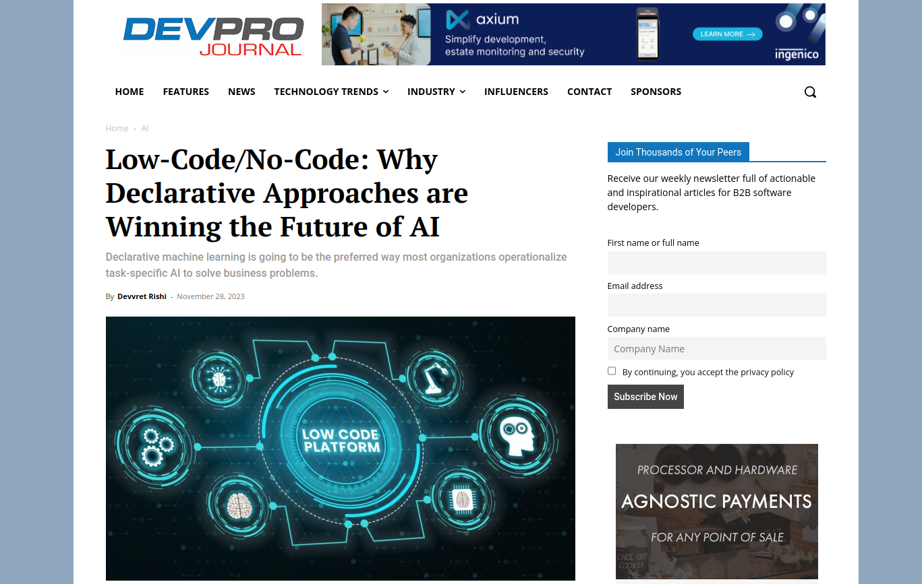
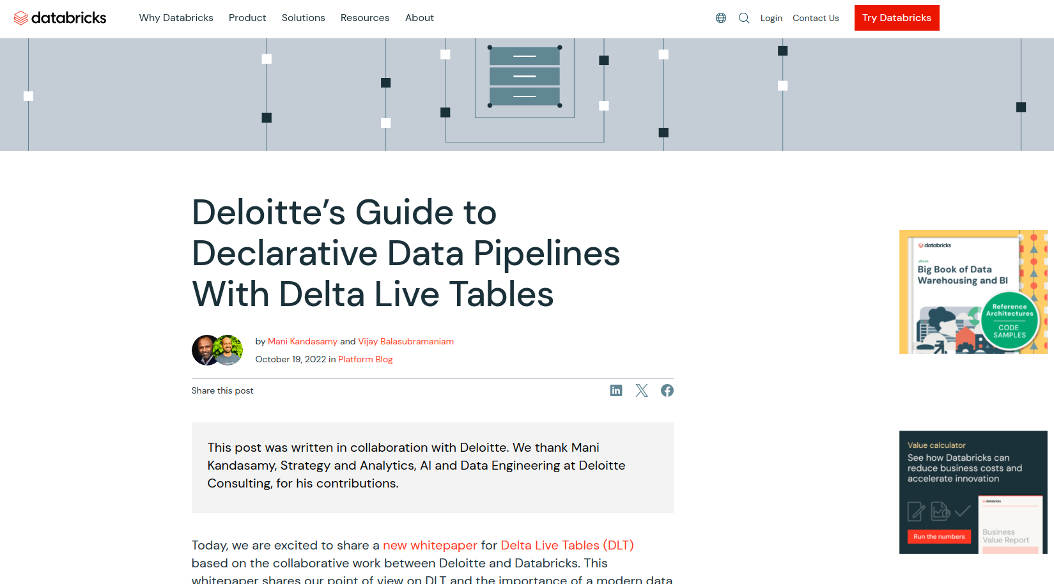

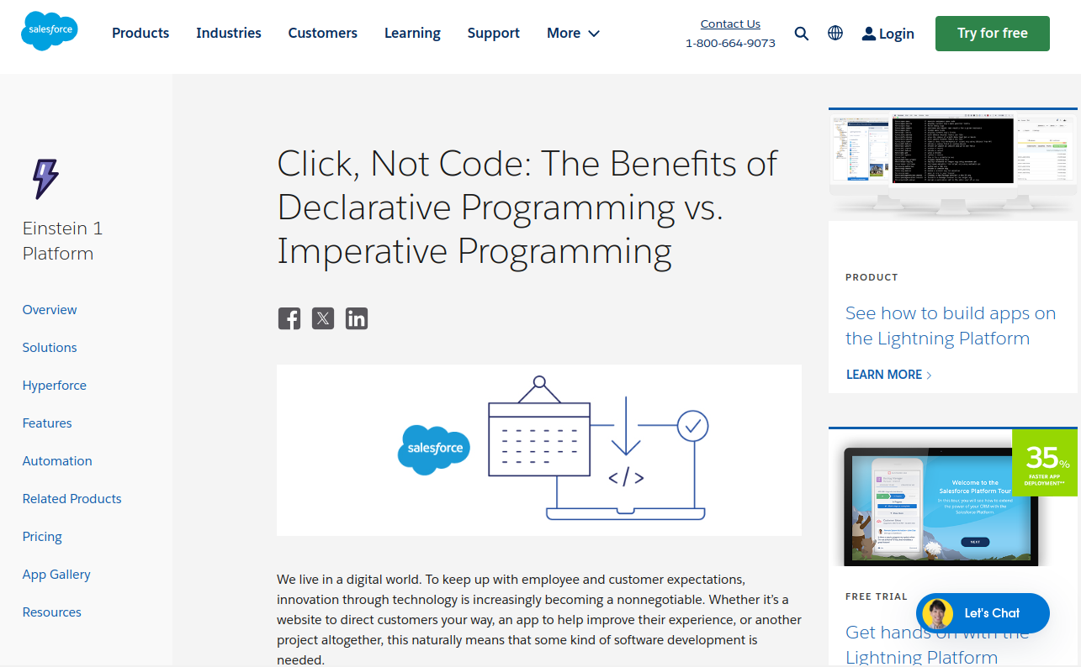
Declarative Analytics on Heterogeneous Exascale Systems
Enables drag-and-drop like analytics pipeline to make informed business decisions without the need for complex coding
Makrynioti, N., & Vassalos, V. (2019). Declarative data analytics: A survey. IEEE Transactions on Knowledge and Data Engineering, 33(6), 2392-2411.
Salesforce. (2024). Click, Not Code: The Benefits of Declarative Programming vs. Imperative Programming retrieved from https://www.salesforce.com/products/platform/best-practices/declarative-programming-vs-imperative-programming/ on 01/24/2026

Slide 4
Table of Contents
Exascale Computing
Datalog
Iterative Relational Algebra
Parallel Relational Algebra
Our Approaches
Topological Data Analysis for High-Dimensional Data
Future Research Direction
Conclusion

Slide 5



What is Exascale?
Exascale
Datalog
Iterative RA
Topological Data Analysis
Parallel RA
Our approaches
Future work
Conclusion
Ability of a computer system to perform 1 Exaflop or more
1 Exaflop = 1 quintillion flop (10¹⁸) or 10⁹ Gigaflop
Capacity?
Perform as many calculations as about
50 million laptops! Speed? A trillion times faster than a PC!
Rank | Site | Computer | Cores | HPL (Eflop/s)
1 | DOE/SC/ORNL | Frontier | 8,730,112 | 1.194
2 | DOE/SC/ANL | Aurora (Half) | 4,742,808 | 0.585
3 | Microsoft Azure | Eagle | 1,123,200 | 0.561
4 | RIKEN | Fugaku | 7,630,848 | 0.442
5 | EuroHPC/CSC | LUMI | 2,752,704 | 0.379
TOP500 HPL (High-Performance Linpack (HPL) benchmark of high-performance computing (HPC) from November 2023
Merritt, R. (2022, September 16). What is an exaflop? NVIDIA Blog. Retrieved April 9, 2023, from https://blogs.nvidia.com/blog/2022/07/26/what-is-an-exaflop/
Strohmaier , E. et al. (2023, November). TOP500 Lists. HPL. Retrieved January 20, 2024, from https://www.top500.org/lists/top500/2023/11/
Webstudios, G. (2021, August 31). Why countries are competing to build supercomputers? Griffon Webstudios. Retrieved April 9, 2023, from https://griffonwebstudios.com/build-super-computers/

Slide 6
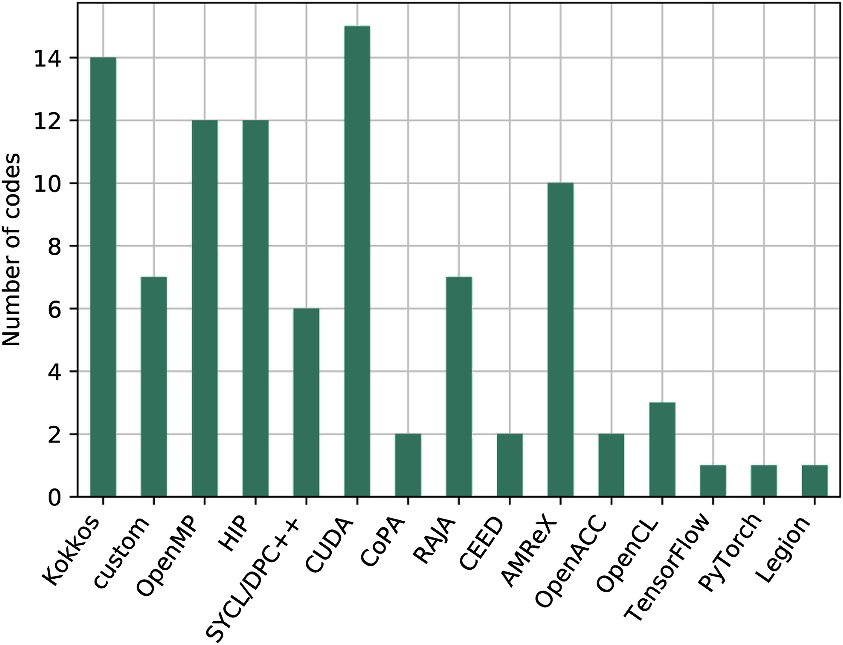
Heterogeneous Exascale Computing Models
Exascale
Datalog
Iterative RA
Topological Data Analysis
Parallel RA
Our approaches
Future work
Conclusion
22 combinations of GPU
Most common: CUDA
Aurora: SYCL (primary), HIP
Frontier: HIP (primary), SYCL
El Capitan: HIP (primary), SYCL
Evans, T. M., Siegel, A., Draeger, E. W., Deslippe, J., Francois, M. M., Germann, T. C., ... & Martin, D. F. (2022). A survey of software implementations used by application codes in the Exascale Computing Project. The International Journal of High Performance Computing Applications, 36(1), 5-12.

Slide 7
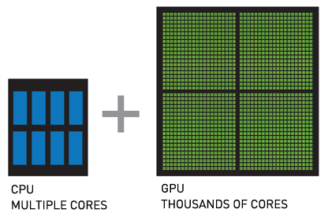
GPGPU
Exascale
Datalog
Iterative RA
Topological Data Analysis
Parallel RA
Our approaches
Future work
Conclusion
General Purpose computing using GPU
Work together with CPU
GPU is designed for parallel processing
Major manufacturers: Nvidia, AMD, Intel
Power efficiency TFlop per Watt
Host
Device

Slide 8
Exascale
Datalog
Iterative RA
Topological Data Analysis
Parallel RA
Our approaches
Future work
Conclusion
Massive parallel processing: Scientific simulations
Efficient large dataset handling: Machine learning algorithms
Real-time processing: Gaming and streaming
Accelerated financial modeling: Risk assessment and pricing
GPGPU Advantages

Slide 9
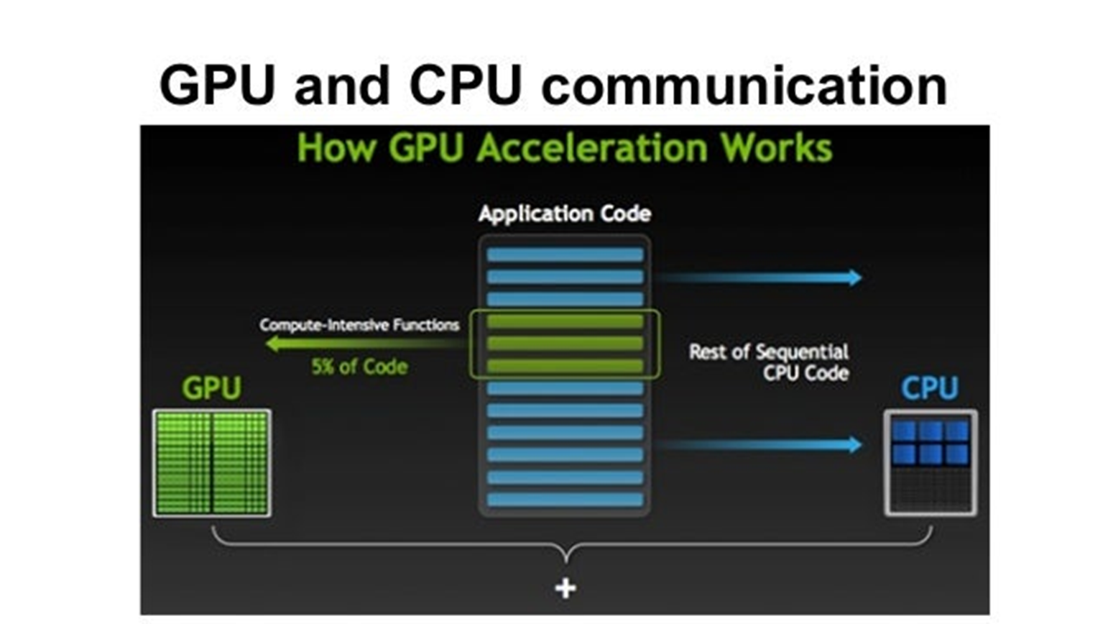
GPU Programming Model
Exascale
Datalog
Iterative RA
Topological Data Analysis
Parallel RA
Our approaches
Future work
Conclusion
CUDA - proprietary to Nvidia GPUs but most mature and established
HIP - targets AMD GPUs, portable
SYCL - open standard for cross-platform portability
DPC++ - Intel's implementation of SYCL
OneAPI - Intel's unified programming model across devices
Jason. Sanders. CUDA by example : an introduction to general-purpose GPU programming. Addison-Wesley, Upper Saddle River, NJ, 2011.
Jianbin Fang, Chun Huang, Tao Tang, and Zheng Wang. Parallel programming models for heterogeneous many-cores: a comprehensive survey. CCF Transactions on High Performance Computing, 2(4):382–400, 2020.

Slide 10
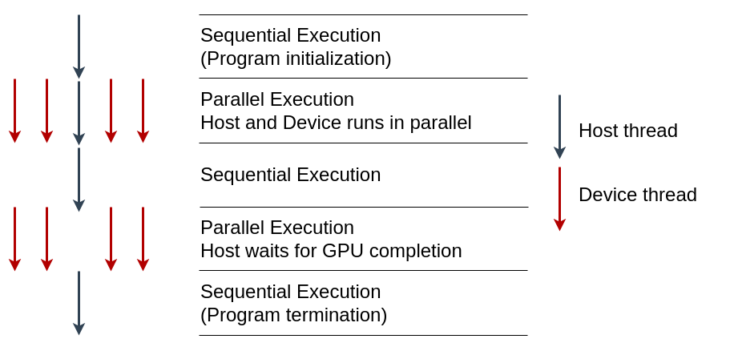
GPU Programming Model
Exascale
Datalog
Iterative RA
Topological Data Analysis
Parallel RA
Our approaches
Future work
Conclusion
Globally Sequential Locally Parallel programming pattern
Invokes parallel kernels that execute across a set of threads
Each thread executes an instance of the kernel
Jason. Sanders. CUDA by example : an introduction to general-purpose GPU programming. Addison-Wesley, Upper Saddle River, NJ, 2011.
Jianbin Fang, Chun Huang, Tao Tang, and Zheng Wang. Parallel programming models for heterogeneous many-cores: a comprehensive survey. CCF Transactions on High Performance Computing, 2(4):382–400, 2020.

Slide 11
GPGPU Challenges
Exascale
Datalog
Iterative RA
Topological Data Analysis
Parallel RA
Our approaches
Future work
Conclusion
Algorithm adaptation Sequential to parallel
synchronization Putting barrier
Memory management H2d and D2h data transfer
Portability different GPU devices
CUDA to SYCL migration retrieved from https://oneapi-sycl-hackathon.devpost.com/ on 01/22/2024
Levinas, M. (2020, November). What is GPU computing and how is it applied today? What Is GPU Computing And How Is It Applied Today? Retrieved from https://blog.cherryservers.com/what-is-gpu-computing

Slide 12
Table of Contents
Exascale Computing
Datalog
Iterative Relational Algebra
Parallel Relational Algebra
Our Approaches
Topological Data Analysis for High-Dimensional Data
Future Research Direction
Conclusion

Slide 13
Datalog: Bottom-Up Logic Programming Language
Exascale
Datalog
Iterative RA
Topological Data Analysis
Parallel RA
Our approaches
Future work
Conclusion
A lightweight logic-programming language for deductive-database systems
Running the Datalog program extends data from input database creating the output database with all data transitively derivable via the program rules
Input Database
Output Database
Datalog
(set of rules)
Ceri, S., Gottlob, G., & Tanca, L. (1989). What you always wanted to know about Datalog(and never dared to ask). IEEE transactions on knowledge and data engineering, 1(1), 146-166.
Gilray, T., Kumar, S., & Micinski, K. (2021, March). Compiling data-parallel datalog. In Proceedings of the 30th ACM SIGPLAN International Conference on Compiler Construction (pp. 23-35).

Slide 14

Datalog Example
Exascale
Datalog
Iterative RA
Topological Data Analysis
Parallel RA
Our approaches
Future work
Conclusion
Facts:
parents(x,y).
children(y,x).
Rules:
grandparent(x,y) :- parents(x,z), parents(z,y).
extensional
intensional
head
body
Michael Stonebraker. Readings in database systems. Morgan Kaufmann Publishers Inc., 1988
Evgeny Dantsin, Thomas Eiter, Georg Gottlob, and Andrei Voronkov. Complexity and expressivepower of logic programming. ACM Comput. Surv., 33(3):374–425, sep 2001.
David Maier, K Tuncay Tekle, Michael Kifer, and David S Warren. Datalog: concepts, history, andoutlook. In Declarative Logic Programming: Theory, Systems, and Applications, pages 3–100. 2018.

Slide 15
Datalog Timeline
Exascale
Datalog
Iterative RA
Topological Data Analysis
Parallel RA
Our approaches
Future work
Conclusion
1970
Horn Clauses, McCarthy
1972
Prolog, Kowalski
1975
Datalog, Maier
1977
1978
Workshop, Gallaire, Minker
LDL, Commercial
Popular, Databases
1980s
Decline, New Technologies
1990s
Regains Popularity, Semantic Web
2000s
Deductive Database, Data Mining, ML
2010s
Stefano Ceri, Georg Gottlob, Letizia Tanca, et al. What you always wanted to know about datalog(andnever dared to ask). IEEE transactions on knowledge and data engineering, 1(1):146–166, 1989
David Maier, K Tuncay Tekle, Michael Kifer, and David S Warren. Datalog: concepts, history, andoutlook. In Declarative Logic Programming: Theory, Systems, and Applications, pages 3–100. 2018.
Shan Shan Huang, Todd Jeffrey Green, and Boon Thau Loo. Datalog and emerging applications:An interactive tutorial. In Proceedings of the 2011 ACM SIGMOD International Conference onManagement of Data, SIGMOD ’11, page 1213–1216, New York, NY, USA, 2011. Association forComputing Machinery.
Notes:
Here is a timeline of the development of Datalog:
1970: John McCarthy publishes the paper "A Formal Description of Data Languages". This paper introduces the concept of Horn clauses, which are the basis of Datalog.
1972: Robert Kowalski publishes the paper "Logic for Problem Solving". This paper introduces the logic programming language Prolog, which is based on Horn clauses.
1975: David Maier coins the term "Datalog".
1977: Hervé Gallaire and Jack Minker organize a workshop on logic and databases. This workshop helps to raise awareness of Datalog and its potential for database applications.
1978: The first commercial Datalog system, called LDL, is released.
1980s: Datalog becomes increasingly popular for database applications.
1990s: The development of new database technologies, such as object-oriented databases and relational databases with triggers, leads to a decline in the popularity of Datalog.
2000s: Datalog regains some popularity due to its simplicity and efficiency. It is also used in new application areas, such as the Semantic Web.
2010s: Datalog continues to be used in a variety of applications, including database querying, data mining, and machine learning.

Slide 16
Declarative Analytics Domains
Exascale
Datalog
Iterative RA
Topological Data Analysis
Parallel RA
Our approaches
Future work
Conclusion
Focuses on the desired output
Utilizes modern Datalog implementation
Domains
Deductive database
Machine learning
Software analysis
Business analytics
Martin Bravenboer and Yannis Smaragdakis. Strictly declarative specification of sophisticated points-toanalyses. In Proceedings of the 24th ACM SIGPLAN conference on Object oriented programming systems languages and applications, pages 243–262, 2009.
Jiwon Seo, Stephen Guo, and Monica S Lam. Socialite: Datalog extensions for efficient social networkanalysis. In 2013 IEEE 29th International Conference on Data Engineering (ICDE), pages 278–289.IEEE, 2013

Slide 17
Classic Problems for Datalog
Exascale
Datalog
Iterative RA
Topological Data Analysis
Parallel RA
Our approaches
Future work
Conclusion
Transitive closure
Triangle counting
Finding maximal cliques
Finding frequent itemsets
Data mining
Oege De Moor, Georg Gottlob, Tim Furche, and Andrew Sellers. Datalog Reloaded: First InternationalWorkshop, Datalog 2010, Oxford, UK, March 16-19, 2010. Revised Selected Papers, volume 6702.Springer, 2012.
Jiwon Seo, Stephen Guo, and Monica S Lam. Socialite: Datalog extensions for efficient social networkanalysis. In 2013 IEEE 29th International Conference on Data Engineering (ICDE), pages 278–289.IEEE, 2013.

Slide 18
Assessment of Datalog Solvers
Exascale
Datalog
Iterative RA
Topological Data Analysis
Parallel RA
Our approaches
Future work
Conclusion
Solver | Technique | Data parallelism | Scalability | Limitations
LogicBlox | Shared memory | No | High | Limited number of threads
Soufflé | Multi core | No | Limited | Internal locking, single node
RadLog | Map Reduce | Yes | Limited | Inadequate for HPC
PRAM | Data parallel | Yes | High | Worse than Soufflé on AWS
SLOG | Data parallel | Yes | High | No GPU usage
Molham Aref, Balder ten Cate, Todd J. Green, Benny Kimelfeld, Dan Olteanu, Emir Pasalic, Todd L.Veldhuizen, and Geoffrey Washburn. Design and implementation of the logicblox system. In Proceedings of the 2015 ACM SIGMOD International Conference on Management of Data, SIGMOD ’15, page1371–1382, New York, NY, USA, 2015. Association for Computing Machinery
Alexander Shkapsky, Mohan Yang, Matteo Interlandi, Hsuan Chiu, Tyson Condie, and Carlo Zaniolo. Big data analytics with datalog queries on spark. In Proceedings of the 2016 International Conference on Management of Data, pages 1135–1149, 2016.
Herbert Jordan, Bernhard Scholz, and Pavle Suboti´c. Souffl´e: On synthesis of program analyzers. In International Conference on Computer Aided Verification, pages 422–430. Springer, 2016.
Thomas Gilray, Sidharth Kumar, and Kristopher Micinski. Compiling data-parallel datalog. In Proceedings of the 30th ACM SIGPLAN International Conference on Compiler Construction, CC 2021,page 23–35, New York, NY, USA, 2021. Association for Computing Machinery.
Thomas Gilray, Arash Sahebolamri, Sidharth Kumar, and Kristopher Micinski. Higher-order, data parallel structured deduction. arXiv preprint arXiv:2211.11573, 2022.

Slide 19
Table of Contents
Exascale Computing
Datalog
Iterative Relational Algebra
Parallel Relational Algebra
Our Approaches
Topological Data Analysis for High-Dimensional Data
Future Research Direction
Conclusion

Slide 20
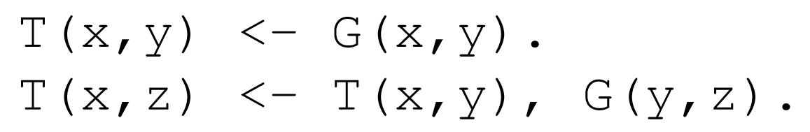
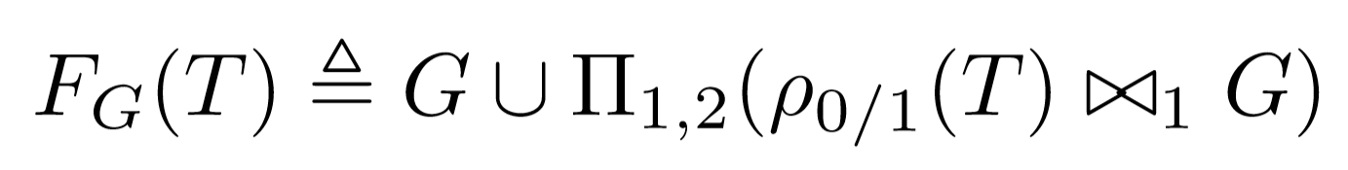
Bottom-Up Logic Programming with Datalog
Exascale
Datalog
Iterative RA
Topological Data Analysis
Parallel RA
Our approaches
Future work
Conclusion
Datalog rule for computing Transitive Closure (TC)
Datalog
Operationalized as a fixed-point iteration using F_{G}
Iterated
Relational Algebra
Relational algebra:
Union
Projection
Join
Gilray, T., & Kumar, S. (2019, December). Distributed relational algebra at scale. In 2019 IEEE 26th International Conference on High Performance Computing, Data, and Analytics (HiPC) (pp. 12-22). IEEE.
Kumar, S., & Gilray, T. (2020, June). Load-balancing parallel relational algebra. In International Conference on High Performance Computing (pp. 288-308). Springer, Cham.

Slide 21
Transitive Closure: Logical Inference for Graphs
Exascale
Datalog
Iterative RA
Topological Data Analysis
Parallel RA
Our approaches
Future work
Conclusion
1
G
1
T
T(x,y) <- G(x,y)
T(x,z) <- T(x,y),G(y,z)
0
3
4
0
3
4
2
2
0​ | 1​
0 | 2​
1​ | 3​
2​ | 3​
3 | 4
0​ | 1​
0​ | 2​
1​ | 3​
2​ | 3​
3​ | 4​
0​ | 3​
1​ | 4​
2​ | 4​
0​ | 4​

Slide 22
Transitive Closure: Iterations
1
T
0
3
4
2
0​ | 1​
0​ | 2​
1​ | 3​
2​ | 3​
3​ | 4​

Slide 23
Transitive Closure: Iterations
ρ_{0/1}(T)
G
1 | 0
2​ | 0
3 | 1
3 | 2
4​ | 3
⨝
0​ | 1​
0​ | 2​
1​ | 3​
2​ | 3​
3​ | 4​

Slide 24
Transitive Closure: Iterations
ρ_{0/1}(T)
G
ρ_{0/1}(T) ⨝ G
1 | 0
2​ | 0
3 | 1
3 | 2
4​ | 3
⨝
0​ | 1​
0​ | 2​
1​ | 3​
2​ | 3​
3​ | 4​
1 | 0 | 3

Slide 25
Transitive Closure: Iterations
ρ_{0/1}(T)
G
ρ_{0/1}(T) ⨝ G
1 | 0
2​ | 0
3 | 1
3 | 2
4​ | 3
⨝
0​ | 1​
0​ | 2​
1​ | 3​
2​ | 3​
3​ | 4​
1 | 0 | 3
2 | 0 | 3

Slide 26
Transitive Closure: Iterations
ρ_{0/1}(T)
G
ρ_{0/1}(T) ⨝ G
1 | 0
2​ | 0
3 | 1
3 | 2
4​ | 3
⨝
0​ | 1​
0​ | 2​
1​ | 3​
2​ | 3​
3​ | 4​
1 | 0 | 3
2 | 0 | 3
3 | 1 | 4

Slide 27
Transitive Closure: Iterations
ρ_{0/1}(T)
G
ρ_{0/1}(T) ⨝ G
1 | 0
2​ | 0
3 | 1
3 | 2
4​ | 3
⨝
0​ | 1​
0​ | 2​
1​ | 3​
2​ | 3​
3​ | 4​
1 | 0 | 3
2 | 0 | 3
3 | 1 | 4
3 | 2 | 4

Slide 28
Transitive Closure: Iterations
ρ_{0/1}(T)
G
ρ_{0/1}(T) ⨝ G
Π_{1, 2}(ρ_{0/1}(T) ⨝ G)
1 | 0
2​ | 0
3 | 1
3 | 2
4​ | 3
⨝
0​ | 1​
0​ | 2​
1​ | 3​
2​ | 3​
3​ | 4​
1 | 0 | 3
2 | 0 | 3
3 | 1 | 4
3 | 2 | 4
0 | 3
1 | 4
2 | 4

Slide 29
Transitive Closure: Iterations 1
1
1
T
0
3
4
0
3
4
2
2
0​ | 1​
0​ | 2​
1​ | 3​
2​ | 3​
3​ | 4​
0​ | 1​
0​ | 2​
1​ | 3​
2​ | 3​
3​ | 4​
0​ | 3​
1​ | 4​
2​ | 4​

Slide 30
Transitive Closure: Iterations 2
1
1
1
T
0
3
4
0
3
4
0
3
4
2
2
2
0​ | 1​
0​ | 2​
1​ | 3​
2​ | 3​
3​ | 4​
0​ | 1​
0​ | 2​
1​ | 3​
2​ | 3​
3​ | 4​
0​ | 3​
1​ | 4​
2​ | 4​
0​ | 1​
0​ | 2​
1​ | 3​
2​ | 3​
3​ | 4​
0​ | 3​
1​ | 4​
2​ | 4​
0​ | 4​

Slide 31
Transitive Closure: Iterations 3
Union
Projection
Join
1
1
1
1
T
0
3
4
0
3
4
0
3
4
0
3
4
2
2
2
2
0​ | 1​
0​ | 2​
1​ | 3​
2​ | 3​
3​ | 4​
0​ | 1​
0​ | 2​
1​ | 3​
2​ | 3​
3​ | 4​
0​ | 3​
1​ | 4​
2​ | 4​
0​ | 1​
0​ | 2​
1​ | 3​
2​ | 3​
3​ | 4​
0​ | 3​
1​ | 4​
2​ | 4​
0​ | 4​
0​ | 1​
0​ | 2​
1​ | 3​
2​ | 3​
3​ | 4​
0​ | 3​
1​ | 4​
2​ | 4​
0​ | 4​

Slide 32
Table of Contents
Exascale Computing
Datalog
Iterative Relational Algebra
Parallel Relational Algebra
Our Approaches
Topological Data Analysis for High-Dimensional Data
Future Research Direction
Conclusion

Slide 33
How can we do join in parallel?
Exascale
Datalog
Iterative RA
Topological Data Analysis
Parallel RA
Our approaches
Future work
Conclusion
Order (Inner Relation)
User (Outer Relation)
UserID | OrderTotal | Items
101 | 25.69 | 2
102 | 145.66 | 3
103 | 12.11 | 1
103 | 44.00 | 2
UserID | UserName | UserEmail
101 | Alice | alice@example.com
102 | Bob | bob@example.com
103 | Eve | eve@example.com
⨝

Slide 34
Parallel Join ⨝
Exascale
Datalog
Iterative RA
Topological Data Analysis
Parallel RA
Our approaches
Future work
Conclusion
Order (Inner Relation)
User (Outer Relation)
UserID | OrderTotal | Items
101 | 25.69 | 2
102 | 145.66 | 3
103 | 12.11 | 1
103 | 44.00 | 2
UserID | UserName | UserEmail
101 | Alice | alice@example.com
102 | Bob | bob@example.com
103 | Eve | eve@example.com
⨝
Thread 1
Thread 2
All executing in parallel
Thread 3

Slide 35
Parallel Join
Exascale
Datalog
Iterative RA
Topological Data Analysis
Parallel RA
Our approaches
Future work
Conclusion
Parallel Join
Algorithms
Hardwares
Load balancing

Slide 36
Comparison of Join Algorithms
Exascale
Datalog
Iterative RA
Topological Data Analysis
Parallel RA
Our approaches
Future work
Conclusion
Algorithm | Pros | Cons | Dataset
Non indexed nested loop | Simple | High time complexity, low efficiency | Small
Indexed nested loop | Index for faster performance | High memory usage | Small to medium, indexed tables
Sort merge | Scalable, handles non-equality joins | Requires sorting, high memory usage | Medium
Hash | Scalable, handles equality joins | Requires partitioning, cannot do non-equality | Large
Hybrid (sort + hash) | Reduce communication cost, Handles skewed data | Complex, requires tuning | Large
Bingsheng He, Ke Yang, Rui Fang, Mian Lu, Naga Govindaraju, Qiong Luo, and Pedro Sander. Relational joins on graphics processors. In Proceedings of the 2008 ACM SIGMOD international conference on Management of data, pages 511–524, 2008.
Ran Rui, Hao Li, and Yi-Cheng Tu. Join algorithms on gpus: A revisit after seven years. In 2015 IEEE International Conference on Big Data (Big Data), pages 2541–2550. IEEE, 2015.
Ran Rui, Hao Li, and Yi Cheng Tu. Efficient join algorithms for large database tables in a multi-gpu environment. Proceedings of the VLDB Endowment, 14:708–720, 2020.
Daniel Zinn, Haicheng Wu, Jin Wang, Molham Aref, and Sudhakar Yalamanchili. General-purpose join algorithms for large graph triangle listing on heterogeneous systems. In Proceedings of the 9th Annual Workshop on General Purpose Processing Using Graphics Processing Unit, pages 12–21, 2016.
Claude Barthels, Ingo M¨uller, Timo Schneider, Gustavo Alonso, and Torsten Hoefler. Distributed join algorithms on thousands of cores. Proc. VLDB Endow., 10(5):517–528, jan 2017
Chengxin Guo, Hong Chen, Feng Zhang, and Cuiping Li. Parallel hybrid join algorithm on gpu. 2019 IEEE 21st International Conference on High Performance Computing and Communications; IEEE 17th International Conference on Smart City; IEEE 5th International Conference on Data Science and Systems (HPCC/SmartCity/DSS), pages 1572–1579, 2019

Slide 37
Parallel Join
Exascale
Datalog
Iterative RA
Topological Data Analysis
Parallel RA
Our approaches
Future work
Conclusion
Parallel Join
Algorithms
Hardwares
Load balancing

Slide 38
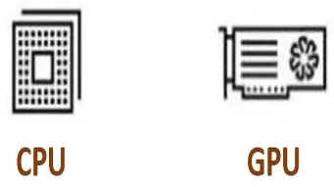
Join on CPUs: Multi-core HJ and SMJ
Exascale
Datalog
Iterative RA
Topological Data Analysis
Parallel RA
Our approaches
Future work
Conclusion
Barthels et al. compared HJ and SMJ on distributed multi-core systems using 4096 processor cores (MPI)
Communication inefficiencies can significantly impede performance
More cores not always means better performance, sometimes degrade
Bounded by the low computation capacity of CPUs and higher communication costs
Claude Barthels, Ingo M¨uller, Timo Schneider, Gustavo Alonso, and Torsten Hoefler. Distributed join algorithms on thousands of cores. Proc. VLDB Endow., 10(5):517–528, jan 2017.
Chengxin Guo, Hong Chen, Feng Zhang, and Cuiping Li. Distributed join algorithms on multi-cpu clusters with gpu direct rdma. Proceedings of the 48th International Conference on Parallel Processing,2019.

Slide 39
Join on GPUs: Benchmark
Exascale
Datalog
Iterative RA
Topological Data Analysis
Parallel RA
Our approaches
Future work
Conclusion
Rui et al. assessed NINLJ, INLJ, SMJ, and HJ on modern GPU
Modern GPUs can lead to 20X speedup VS 7X speedup of old GPUs
Not suitable for HPC systems with multiple GPU environments
New GPU architecture is introduced (Nvidia Hopper architecture)
Bingsheng He, Ke Yang, Rui Fang, Mian Lu, Naga Govindaraju, Qiong Luo, and Pedro Sander.Relational joins on graphics processors. In Proceedings of the 2008 ACM SIGMOD internationalconference on Management of data, pages 511–524, 2008.
Ran Rui, Hao Li, and Yi-Cheng Tu. Join algorithms on gpus: A revisit after seven years. In 2015 IEEEInternational Conference on Big Data (Big Data), pages 2541–2550. IEEE, 2015.
Anne C Elster and Tor A Haugdahl. Nvidia hopper gpu and grace cpu highlights. Computing in Science& Engineering, 24(2):95–100, 2022.

Slide 40
Join on GPUs: WarpDrive
Exascale
Datalog
Iterative RA
Topological Data Analysis
Parallel RA
Our approaches
Future work
Conclusion
Jünger et al. presented a single-node multi-GPU hashing for hashjoin
Attained better memory coalescing
Hashtable insertion rate:
1.4B keys/sec (single GPU)
4.3B keys/sec (4 GPUs)
32 bit keys only with no deduplication
Incremental study: WarpCore supports 64 bit keys
Daniel J¨unger, Christian Hundt, and Bertil Schmidt. Warpdrive: Massively parallel hashing on multigpu nodes. In 2018 IEEE International Parallel and Distributed Processing Symposium (IPDPS), pages441–450. IEEE, 2018.
Daniel J¨unger, Robin Kobus, Andr´e M¨uller, Christian Hundt, Kai Xu, Weiguo Liu, and Bertil Schmidt.Warpcore: A library for fast hash tables on gpus. In 2020 IEEE 27th International Conference on HighPerformance Computing, Data, and Analytics (HiPC), pages 11–20, 2020.

Slide 41
Join on GPUs: Secondary storage
Exascale
Datalog
Iterative RA
Topological Data Analysis
Parallel RA
Our approaches
Future work
Conclusion
Zinn et al. presented multi-GPUs join with secondary storage support
Focused on triangle counting problem
Allow overfitting global GPU memory with SSD storage
Leapfrog Triejoin (LFTJ) algorithm: a worst-case-optimal algorithm
No mention of multi-node heterogeneous systems
Daniel Zinn, Haicheng Wu, Jin Wang, Molham Aref, and Sudhakar Yalamanchili. General-purpose joinalgorithms for large graph triangle listing on heterogeneous systems. In Proceedings of the 9th AnnualWorkshop on General Purpose Processing Using Graphics Processing Unit, pages 12–21, 2016.

Slide 42
Parallel Join
Exascale
Datalog
Iterative RA
Topological Data Analysis
Parallel RA
Our approaches
Future work
Conclusion
Parallel Join
Algorithms
Hardwares
Load balancing

Slide 43
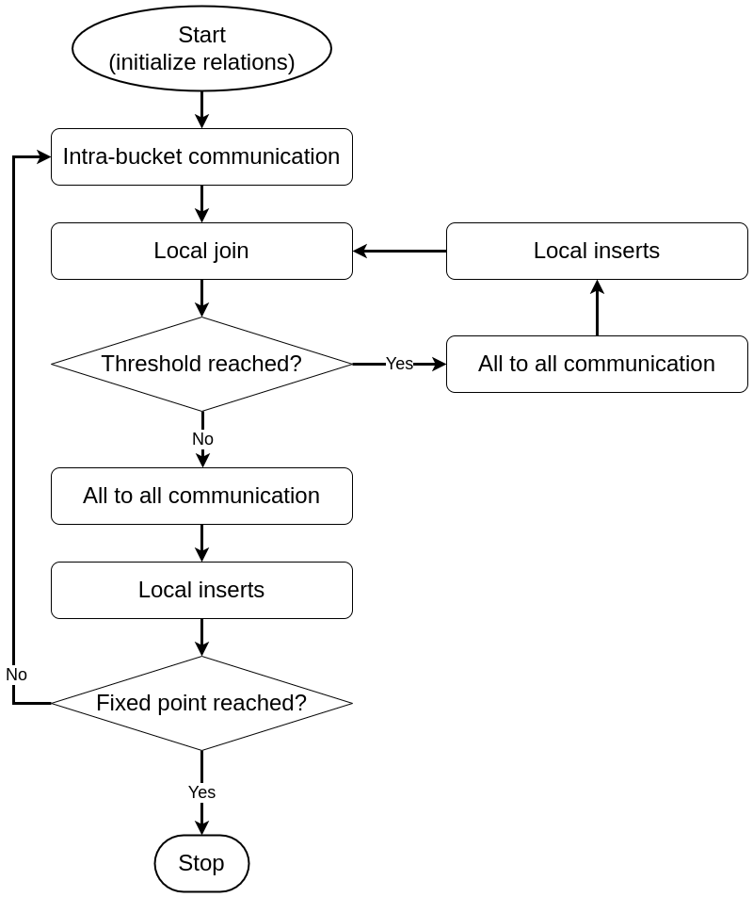
Load Balancing Multi-node Joins
Exascale
Datalog
Iterative RA
Topological Data Analysis
Parallel RA
Our approaches
Future work
Conclusion
2 types of load imbalance issues:
Spatial: across multiple computing nodes
Temporal: distributing newly discovered tuples
Solutions: Bucket refinement,consolidation,Iteration rollover
Range of favorable scaling exists: 256 to 32K processes
Performance deteriorates beyond that range
Handling temporal load imbalance during the join
Sidharth Kumar and Thomas Gilray. Distributed relational algebra at scale. In International Conferenceon High Performance Computing, Data, and Analytics (HiPC). IEEE, 2019.
Sidharth Kumar and Thomas Gilray. Load-balancing parallel relational algebra. In InternationalConference on High Performance Computing, pages 288–308. Springer, 2020.
Notes:
An all-to-all communication is initiated during the local-join phase once a particular threshold value is reached. This communication phase is followed by a local insertion phase where the tuples are inserted into the appropriate destination rank. The previous iteration continues precisely where it left off, as opposed to coming to an end. Next, it checks if the fixed point iteration is reached and if not it reinstates the intra-bucket communication.
Bucket refinement phase checks if subbuckets contains more tuples than average and refines their size to allow allocating the extra tuples
Bucket consolidation ensures the refined subbuckets are combined together when the spatial load balance resolved
Iteration rollover technique prevents memory overflow
Range of favorable scaling exists for workload with optimal number of processes (evaluated from 256 to 32,768 processes)
Performance deteriorates beyond that range due to less workload per process and additional communication costs

Slide 44
Table of Contents
Exascale Computing
Datalog
Iterative Relational Algebra
Parallel Relational Algebra
Our Approaches
Topological Data Analysis for High-Dimensional Data
Future Research Direction
Conclusion

Slide 45
First approach: Off-the-shelf RA Data Structure
Exascale
Datalog
Iterative RA
Topological Data Analysis
Parallel RA
Our approaches
Future work
Conclusion

Slide 46
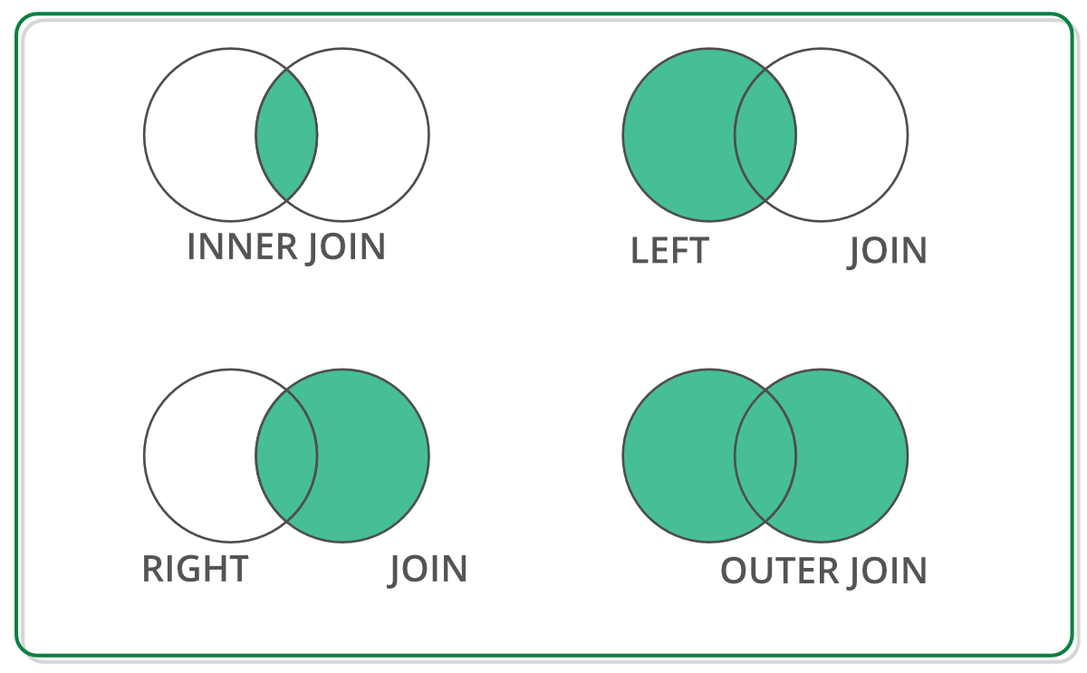
Off-the-shelf Data Structure for RA Operation
Exascale
Datalog
Iterative RA
Topological Data Analysis
Parallel RA
Our approaches
Future work
Conclusion
DataFrame has RA primitives APIs
DataFrame: 2D labeled tabular data structure
Reback, J., McKinney, W., Van Den Bossche, J., Augspurger, T., Cloud, P., Klein, A., ... & Seabold, S. (2020). pandas-dev/pandas: Pandas 1.0. 5. Zenodo.
Chen, D. Y. (2017). Pandas for everyone: Python data analysis. Addison-Wesley Professional.
Singh, R. (2020, July 1). Merging DataFrames with Pandas: Pd.merge(). Medium. Retrieved April 8, 2023, from https://medium.com/swlh/merging-dataframes-with-pandas-pd-merge-7764c7e2d46d

Slide 47


Off-the-shelf Python Libraries
Exascale
Datalog
Iterative RA
Topological Data Analysis
Parallel RA
Our approaches
Future work
Conclusion
DataFrame: 2D labeled tabular data structure
GPU (NVIDIA cuDF)
CPU
Both supports join operation with similar APIs
Reback, J., McKinney, W., Van Den Bossche, J., Augspurger, T., Cloud, P., Klein, A., ... & Seabold, S. (2020). pandas-dev/pandas: Pandas 1.0. 5. Zenodo.
Chen, D. Y. (2017). Pandas for everyone: Python data analysis. Addison-Wesley Professional.
Green, O., Du, Z., Patel, S., Xie, Z., Liu, H., & Bader, D. A. (2021, December). Anti-Section Transitive Closure. In 2021 IEEE 28th International Conference on High Performance Computing, Data, and Analytics (HiPC) (pp. 192-201). IEEE.
Fender, A., Rees, B., & Eaton, J. RAPIDS cuGraph. In Massive Graph Analytics (pp. 483-493). Chapman and Hall/CRC.

Slide 48
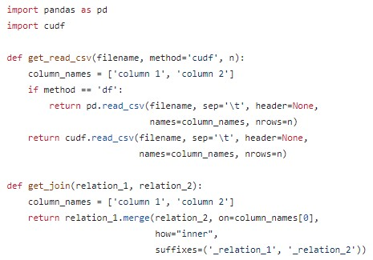
CPU (Pandas) and GPU (cuDF)
Exascale
Datalog
Iterative RA
Topological Data Analysis
Parallel RA
Our approaches
Future work
Conclusion
CPU Environment
GPU Environment
https://github.com/harp-lab/GPUJoin/edit/main/IA3_2022/basic_operations.py

Slide 49
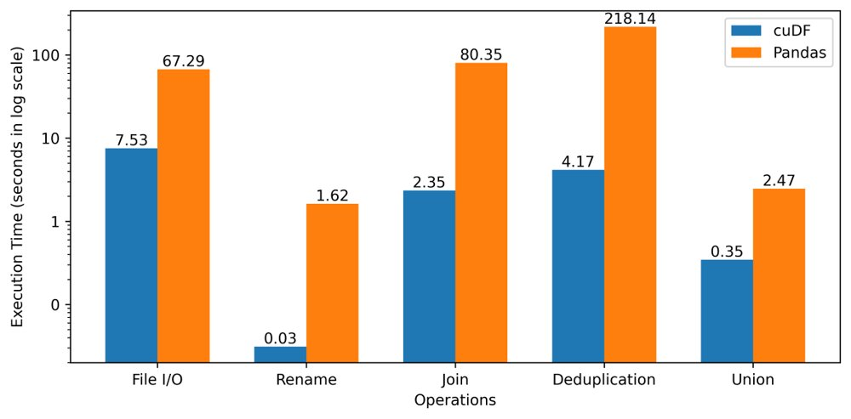
Performance Improvement: RA operations
Exascale
Datalog
Iterative RA
Topological Data Analysis
Parallel RA
Our approaches
Future work
Conclusion
8.9x
52.2x
34.1x
52.4x
7.1x
A. R. Shovon, L. R. Dyken, O. Green, T. Gilray and S. Kumar, "Accelerating Datalog applications with cuDF," 2022 IEEE/ACM Workshop on Irregular Applications: Architectures and Algorithms (IA3), Dallas, TX, USA, 2022, pp. 41-45
Leadership Computing Facility, A. (2022). Argonne Leadership Computing Facility. Theta GPU Nodes. URL: https://www.alcf.anl.gov/support-center/theta-gpu-nodes

Slide 50
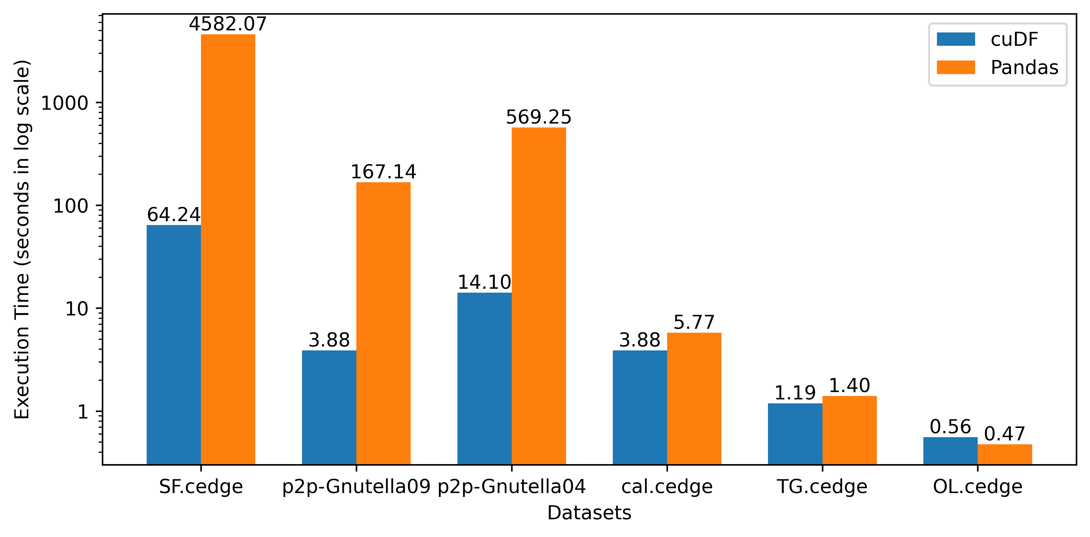
Performance Improvement: Transitive Closure
Exascale
Datalog
Iterative RA
Topological Data Analysis
Parallel RA
Our approaches
Future work
Conclusion
71.3x
43.1x
40.4x
1.5x
1.2x
0.9x
A. R. Shovon, L. R. Dyken, O. Green, T. Gilray and S. Kumar, "Accelerating Datalog applications with cuDF," 2022 IEEE/ACM Workshop on Irregular Applications: Architectures and Algorithms (IA3), Dallas, TX, USA, 2022, pp. 41-45
Leadership Computing Facility, A. (2022). Argonne Leadership Computing Facility. Theta GPU Nodes. URL: https://www.alcf.anl.gov/support-center/theta-gpu-nodes

Slide 51
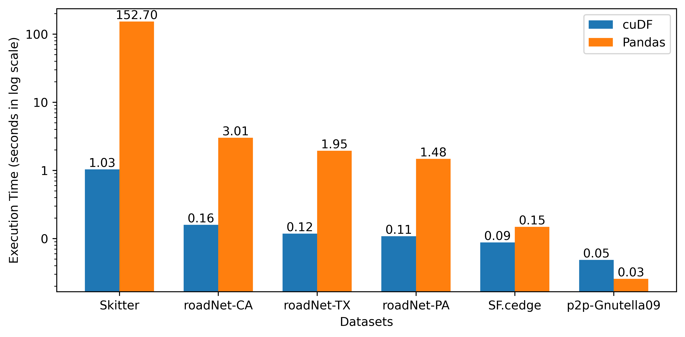
Performance Improvement: Triangle Counting
Exascale
Datalog
Iterative RA
Topological Data Analysis
Parallel RA
Our approaches
Future work
Conclusion
147.7x
18.9x
16.5x
13.6x
1.7x
0.5x
A. R. Shovon, L. R. Dyken, O. Green, T. Gilray and S. Kumar, "Accelerating Datalog applications with cuDF," 2022 IEEE/ACM Workshop on Irregular Applications: Architectures and Algorithms (IA3), Dallas, TX, USA, 2022, pp. 41-45
Leadership Computing Facility, A. (2022). Argonne Leadership Computing Facility. Theta GPU Nodes. URL: https://www.alcf.anl.gov/support-center/theta-gpu-nodes

Slide 52
DataFrame Based Datalog Applications
Exascale
Datalog
Iterative RA
Topological Data Analysis
Parallel RA
Our approaches
Future work
Conclusion
Advantages
Abstract memory management
Abstract thread block configuration
Same API signatures for CPU and GPU
Easy-to-code interface
A. R. Shovon, L. R. Dyken, O. Green, T. Gilray and S. Kumar, "Accelerating Datalog applications with cuDF," 2022 IEEE/ACM Workshop on Irregular Applications: Architectures and Algorithms (IA3), Dallas, TX, USA, 2022, pp. 41-45
Green, O., Du, Z., Patel, S., Xie, Z., Liu, H., & Bader, D. A. (2021, December). Anti-Section Transitive Closure. In 2021 IEEE 28th International Conference on High Performance Computing, Data, and Analytics (HiPC) (pp. 192-201). IEEE.
Team, R. D. (2018). RAPIDS: Collection of libraries for end to end GPU data science. NVIDIA, Santa Clara, CA, USA. https://rapids.ai

Slide 53
Improvement Opportunity for TC
Exascale
Datalog
Iterative RA
Topological Data Analysis
Parallel RA
Our approaches
Future work
Conclusion
Open-addressing based hashtable
Fuse join and projection
Sorted results for deduplication
Pinned memory scheme
Intermediate memory clearance
A. R. Shovon, L. R. Dyken, O. Green, T. Gilray and S. Kumar, "Accelerating Datalog applications with cuDF," 2022 IEEE/ACM Workshop on Irregular Applications: Architectures and Algorithms (IA3), Dallas, TX, USA, 2022, pp. 41-45
Green, O., Du, Z., Patel, S., Xie, Z., Liu, H., & Bader, D. A. (2021, December). Anti-Section Transitive Closure. In 2021 IEEE 28th International Conference on High Performance Computing, Data, and Analytics (HiPC) (pp. 192-201). IEEE.

Slide 54
Second approach: Low level iterative hash join
Exascale
Datalog
Iterative RA
Topological Data Analysis
Parallel RA
Our approaches
Future work
Conclusion

Slide 55
Hash Join Process
Exascale
Datalog
Iterative RA
Topological Data Analysis
Parallel RA
Our approaches
Future work
Conclusion
Hash Join Relation
With
Duplicate records
Hash Join Relation
With
Duplicate records
Hash Join Relation
Without
Duplicate records
⨝
Hash Table
Inner
Relation
Deduplication

Slide 56
Hash Table (Open Addressing, Linear Probing)
Exascale
Datalog
Iterative RA
Topological Data Analysis
Parallel RA
Our approaches
Future work
Conclusion
Grid Stride Loop
0
1
...
511
. . .
Block 0
35
44
11
23
. . .
. . .
0
1
...
511
46
31
. . .
Block n
97
32
CUDA Threads
Key - Value
Hash Table
Key-Value Pair

Slide 57
Hash Table (Open Addressing, Linear Probing)
Exascale
Datalog
Iterative RA
Topological Data Analysis
Parallel RA
Our approaches
Future work
Conclusion
Grid Stride Loop
Murmur 3 hashing
0
1
...
511
35
44
. . .
Block 0
35
44
11
23
11
23
. . .
. . .
0
1
...
511
AtomicCAS
46
31
. . .
Block n
97
32
CUDA Threads
Key - Value
Hash Table
Key-Value Pair

Slide 58
Hash Table (Open Addressing, Linear Probing)
Exascale
Datalog
Iterative RA
Topological Data Analysis
Parallel RA
Our approaches
Future work
Conclusion
Grid Stride Loop
Murmur 3 hashing
0
1
...
511
35
44
. . .
Block 0
35
44
11
23
11
23
. . .
. . .
0
1
...
511
AtomicCAS
46
31
. . .
Block n
97
32
CUDA Threads
Key - Value
Hash Table
Key-Value Pair

Slide 59
Hash Table (Open Addressing, Linear Probing)
Exascale
Datalog
Iterative RA
Topological Data Analysis
Parallel RA
Our approaches
Future work
Conclusion
Grid Stride Loop
Murmur 3 hashing
0
1
...
511
35
44
. . .
Block 0
35
44
11
23
11
23
. . .
. . .
0
1
...
511
AtomicCAS
46
31
. . .
Block n
97
32
CUDA Threads
Key - Value
Hash Table
Key-Value Pair

Slide 60
Hash Table (Open Addressing, Linear Probing)
Exascale
Datalog
Iterative RA
Topological Data Analysis
Parallel RA
Our approaches
Future work
Conclusion
Grid Stride Loop
Murmur 3 hashing
0
1
...
511
35
44
. . .
Block 0
35
44
11
23
11
23
. . .
. . .
0
1
...
511
AtomicCAS
46
31
. . .
Block n
97
32
Collision -> Linear probing (Position + 1) & hash table size
CUDA Threads
Key - Value
Hash Table
Key-Value Pair

Slide 61
Hash Table (Open Addressing, Linear Probing)
Exascale
Datalog
Iterative RA
Topological Data Analysis
Parallel RA
Our approaches
Future work
Conclusion
Grid Stride Loop
Murmur 3 hashing
0
1
...
511
35
44
. . .
Block 0
35
44
11
23
11
23
. . .
. . .
0
1
...
511
AtomicCAS
46
31
. . .
Block n
46
31
97
32
Collision -> Linear probing (Position + 1) & hash table size
97
32
CUDA Threads
Key - Value
Hash Table
Key-Value Pair

Slide 62
Performing Hash Join on GPU
Exascale
Datalog
Iterative RA
Topological Data Analysis
Parallel RA
Our approaches
Future work
Conclusion
Static Hash Table
Inner Relation
Key | Value
Key | Value
Calculate join size
⨝
First pass

Slide 63
Performing Hash Join on GPU
Exascale
Datalog
Iterative RA
Topological Data Analysis
Parallel RA
Our approaches
Future work
Conclusion
Static Hash Table
Inner Relation
Key | Value
Key | Value
Calculate join size
⨝
First pass
Prefix sum
Join Result
Second pass
(fused projection)
Join Key | Value 1 | Value 2

Slide 64
Performing Hash Join on GPU
Exascale
Datalog
Iterative RA
Topological Data Analysis
Parallel RA
Our approaches
Future work
Conclusion
Static Hash Table
Inner Relation
Key | Value
Key | Value
Calculate join size
⨝
First pass
Prefix sum
Join Result
Second pass
(fused projection)
Join Key | Value 1 | Value 2
Sort and Unique
Deduplicated Join Result
Key | Value

Slide 65
CUDA Advantages over cuDF
Exascale
Datalog
Iterative RA
Topological Data Analysis
Parallel RA
Our approaches
Future work
Conclusion
Fuse operations
Thread-block configuration
Memory management
Optimize data structure
Jason. Sanders. CUDA by example : an introduction to general-purpose GPU programming. AddisonWesley, Upper Saddle River, NJ, 2011.
John Cheng, Max Grossman, and Ty McKercher. Professional CUDA c programming. John Wiley & Sons, 2014

Slide 66
Hash Table Performance
Exascale
Datalog
Iterative RA
Topological Data Analysis
Parallel RA
Our approaches
Future work
Conclusion
Build rate:
Random synthetic graph: 400 million keys/second
String graph: 4 billion keys/second
Load factors are varied to ensure less memory overhead

Slide 67
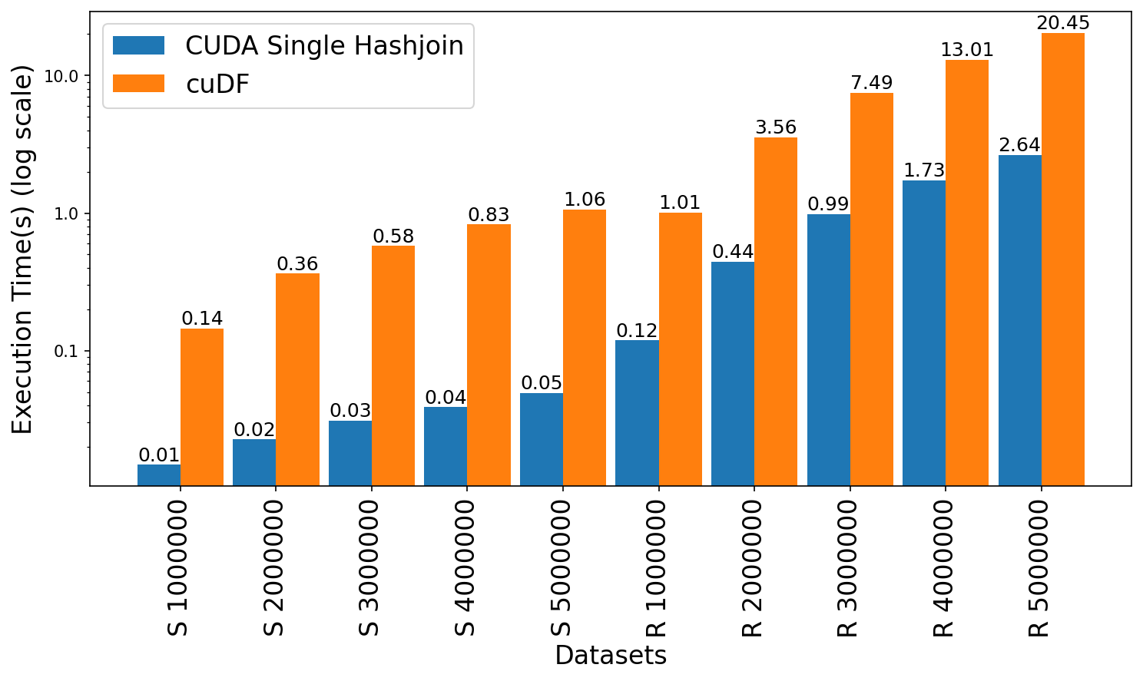
Join Performance Comparison: CUDA vs cuDF
Exascale
Datalog
Iterative RA
Topological Data Analysis
Parallel RA
Our approaches
Future work
Conclusion
Leadership Computing Facility, A. (2022). Argonne Leadership Computing Facility. Theta GPU Nodes. URL: https://www.alcf.anl.gov/support-center/theta-gpu-nodes
Notes:
Observe up to 21x speedup for string graph
Observe 7.6x to 8.4x speedup for random graph

Slide 68
Transitive Closure: CUDA vs Soufflé vs cuDF
Exascale
Datalog
Iterative RA
Topological Data Analysis
Parallel RA
Our approaches
Future work
Conclusion
Dataset | Type | Rows | TC size | Iterations | CUDA Hashjoin(s) | Soufflé(s) | cuDF(s)
fe_ocean | U | 409,593 | 1,669,750,513 | 247 | 138.237 | 536.233 | Out of Memory
p2p-Gnutella31 | D | 147,892 | 884,179,859 | 31 | Out of Memory | 128.917 | Out of memory
usroads | U | 165,435 | 871,365,688 | 606 | 364.554 | 222.761 | Out of Memory
fe_body | U | 163,734 | 156,120,489 | 188 | 47.758 | 29.07 | Out of Memory
loc-Brightkite | U | 214,078 | 138,269,412 | 24 | 15.88 | 29.184 | Out of Memory
SF.cedge | U | 223,001 | 80,498,014 | 287 | 11.274 | 17.073 | 64.417
fe_sphere | U | 49,152 | 78,557,912 | 188 | 13.159 | 20.008 | 80.077
CA-HepTh | D | 51,971 | 74,619,885 | 18 | 4.318 | 15.206 | 26.115
p2p-Gnutella04 | D | 39,994 | 47,059,527 | 26 | 2.092 | 7.537 | 14.005
p2p-Gnutella09 | D | 26,013 | 21,402,960 | 20 | 0.72 | 3.094 | 3.906
wiki-Vote | D | 103,689 | 11,947,132 | 10 | 1.137 | 3.172 | 6.841
cti | U | 48,232 | 6,859,653 | 53 | 0.295 | 1.496 | 3.181
delaunay_n16 | U | 196,575 | 6,137,959 | 101 | 1.137 | 1.612 | 5.596
luxembourg_osm | U | 119,666 | 5,022,084 | 426 | 1.322 | 2.548 | 8.194
ego-Facebook | U | 88,234 | 2,508,102 | 17 | 0.544 | 0.606 | 3.719
cal.cedge | U | 21,693 | 501,755 | 195 | 0.489 | 0.455 | 2.756
TG.cedge | U | 23,874 | 481,121 | 58 | 0.198 | 0.219 | 0.857
wing | U | 121,544 | 329,438 | 11 | 0.085 | 0.193 | 0.905
OL.cedge | U | 7,035 | 146,120 | 64 | 0.148 | 0.181 | 0.523
Leadership Computing Facility, A. (2022). Argonne Leadership Computing Facility. Theta GPU Nodes. URL: https://www.alcf.anl.gov/support-center/theta-gpu-nodes
Notes:
Observe up to 21x speedup for string graph
Observe 7.6x to 8.4x speedup for random graph

Slide 69

Limitations
Exascale
Datalog
Iterative RA
Topological Data Analysis
Parallel RA
Our approaches
Future work
Conclusion
Limited to a single GPU that dictates scaling by available VRAM on the GPU
Memory overflow error for larger graphs
Open addressing based hash table causes memory overhead

Slide 70
Table of Contents
Exascale Computing
Datalog
Iterative Relational Algebra
Parallel Relational Algebra
Our Approaches
Topological Data Analysis for High-Dimensional Data
Future Research Direction
Conclusion

Slide 71
Topological Data Analysis
Exascale
Datalog
Iterative RA
Topological Data Analysis
Parallel RA
Our approaches
Future work
Conclusion
TDA analyzes high-dimensional data sets using algebraic topology
Main tool: persistent homology, adapts homology to point cloud
Analyzes complex systems: social networks, brain connectivity, internet
Extracts topological features and visualizes in lower-dimensional space
M. Rubinov and O. Sporns, “Complex network measures of brain connectivity: uses and interpretations,” Neuroimage, vol. 52, no. 3, pp. 1059–1069, 2010.
Aktas, M.E., Akbas, E. & Fatmaoui, A.E. Persistence homology of networks: methods and applications. Appl Netw Sci 4, 61 (2019). https://doi.org/10.1007/s41109-019-0179-3

Slide 72
PH for High-Dimensional Data Analysis
Exascale
Datalog
Iterative RA
Topological Data Analysis
Parallel RA
Our approaches
Future work
Conclusion
Verify
PH of rs-fMRI can compactly represent topological features of FCNs
Demonstrate
FCN networks are statistically similar despite variations in TRs
Remove
Non-neural variability in multi-site case-control studies
Ashley Suh, Mustafa Hajij, Bei Wang, Carlos Scheidegger, and Paul Rosen. Persistent homologyguided force-directed graph layouts. IEEE Transactions on Visualization and Computer Graphics,26(1):697–707, January 2020
Tananun Songdechakraiwut, Li Shen, and Moo Chung. Topological learning and its application tomultimodal brain network integration. In Medical Image Computing and Computer Assisted Intervention–MICCAI 2021: 24th International Conference, Strasbourg, France, September 27–October 1, 2021,Proceedings, Part II 24, pages 166–176. Springer, 2021.

Slide 73
Table of Contents
Exascale Computing
Datalog
Iterative Relational Algebra
Parallel Relational Algebra
Our Approaches
Topological Data Analysis for High-Dimensional Data
Future Research Direction
Conclusion

Slide 74
Future Research Direction
Exascale
Datalog
Iterative RA
Topological Data Analysis
Parallel RA
Our approaches
Future work
Conclusion
Develop a multi-node multi-GPU backend for Datalog​
Design GPU benchmarking techniques for iterative RA​
Explore PH-based techniques on multi-site temporal brain FCNs​
Develop declarative analytics technique for high-dimensional datasets​

Slide 75
Table of Contents
Exascale Computing
Datalog
Iterative Relational Algebra
Parallel Relational Algebra
Our Approaches
Topological Data Analysis for High-Dimensional Data
Future Research Direction
Conclusion

Slide 76
Conclusion
Exascale
Datalog
Iterative RA
Topological Data Analysis
Parallel RA
Our approaches
Future work
Conclusion
Reviewed Datalog applications on heterogeneous systems
Explored topological data analysis techniques for brain network
Identified research direction for declarative analytics on high-dimensional data

Slide 77
Publications
Ahmedur Rahman Shovon, Landon Richard Dyken, Oded Green, Thomas Gilray, and Sidharth Kumar. Accelerating datalog applications with cudf. In 2022 IEEE/ACM 11th Workshop on Irregular Applications: Architectures and Algorithms (IA3), pages 41–45, 2022​
Ahmedur Rahman Shovon, Thomas Gilray, Kristopher Micinski, and Sidharth Kumar. Towards Iterative Relational Algebra on the GPU. In 2023 USENIX Annual Technical Conference (USENIX ATC 23), pp. 1009-1016.
Yihao Sun, Ahmedur Rahman Shovon, Thomas Gilray, Kristopher Micinski, Sidharth Kumar. Modern Datalog on the GPU, In review.
Sewell, A., Fan, K., Shovon, A. R., Dyken, L., Kumar, S., & Petruzza, S. (2024, January). Bruck Algorithm Performance Analysis for Multi-GPU All-to-All Communication. In Proceedings of the International Conference on High Performance Computing in Asia-Pacific Region (pp. 127-133).
Sidharth Kumar, Ahmedur Rahman Shovon, and Gopikrishna Deshpande. The invariance of persistent homology of brain networks to data acquisition-related non-neural variability in resting state fmri. Human Brain Mapping, 44(13), 4637–4651​
Darshan Shimoga Chandrashekar, Santhosh Kumar Karthikeyan, Praveen Kumar Korla, Henalben Patel, Ahmedur Rahman Shovon, Mohammad Athar, George J Netto, Zhaohui S Qin, Sidharth Kumar, Upender Manne, et al. Ualcan: An update to the integrated cancer data analysis platform. Neoplasia, 25:18–27, 2022.​
Kashyap Balakavi, Rushitha Janga, Ahmedur Rahman Shovon, Don Dempsey, Elliot Lefkowitz, Sidarth Kumar. Scalable, interactive and hierarchical visualization of virus taxonomic data. In 2023 IEEE Workshop on Visual Analytics in Healthcare (VAHC), in conjunction with IEEE VIS 2023.​

Slide 78
Thank You
ashov@uic.edu

Slide 79
Appendix

Slide 80
Parallel Join: Algorithms
Popular algorithms
Non-Indexed Nested Loop Join (NINLJ)
Indexed Nested Loop Join (INLJ)
Sort-Merge Join (SMJ)
Radix Hash Join (HJ)
Sort-merge is suitable for small to medium-sized tables, radix hash join is suitable for large tables
Chengxin Guo, Hong Chen, Feng Zhang, and Cuiping Li. Parallel hybrid join algorithm on gpu. 2019IEEE 21st International Conference on High Performance Computing and Communications; IEEE17th International Conference on Smart City; IEEE 5th International Conference on Data Science andSystems (HPCC/SmartCity/DSS), pages 1572–1579, 2019.
Hongzhi Wang, Ning Li, Zheng ke Wang, and Jianing Li. Gpu-based efficient join algorithms on hadoop.The Journal of Supercomputing, 77:292 – 321, 2020.

Slide 81
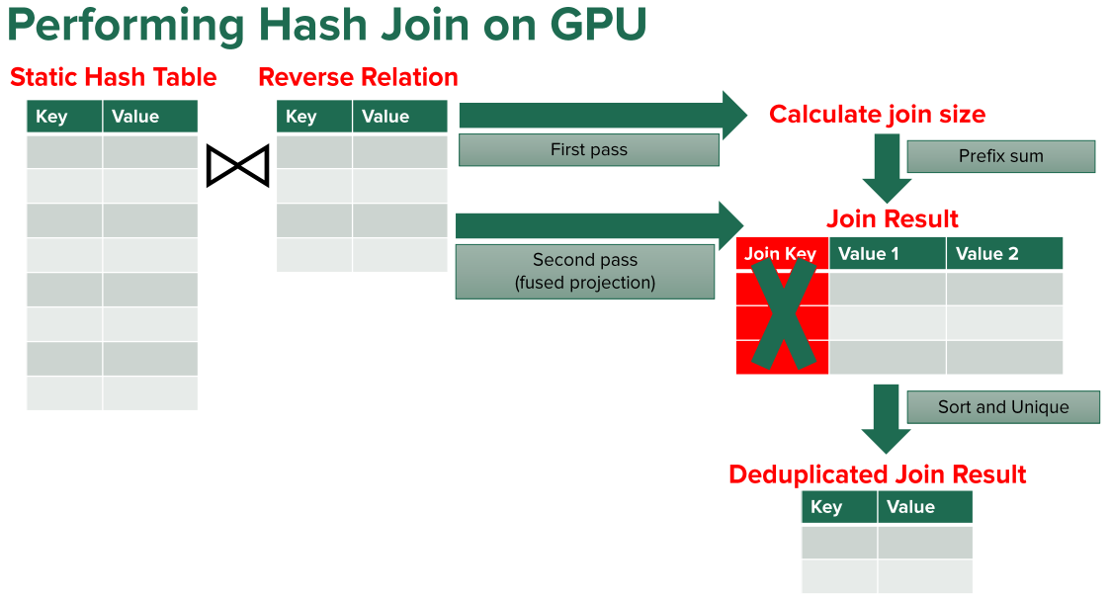
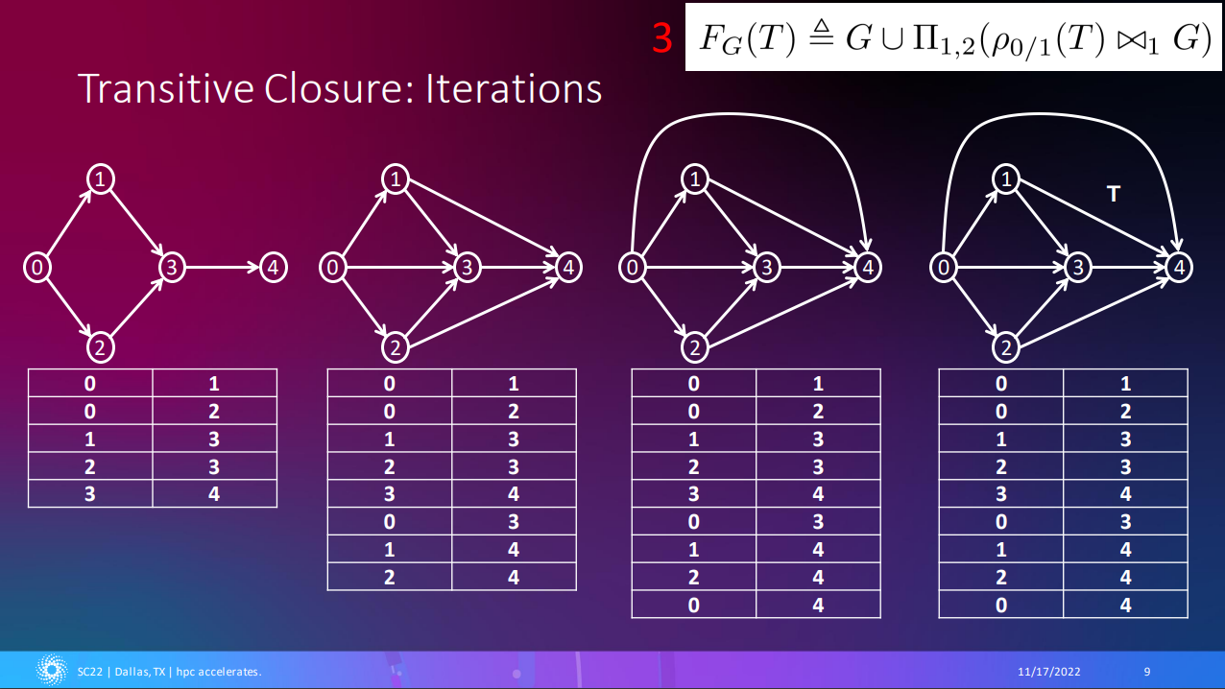
Publications
Shovon, A. R., Gilray, T., Micinski, K., & Kumar, S. (2023). Towards iterative relational algebra on the {GPU}. In 2023 USENIX Annual Technical Conference (USENIX ATC 23) (pp. 1009-1016).
Shovon, A. R., Dyken, L. R., Green, O., Gilray, T., & Kumar, S. (2022, November). Accelerating Datalog applications with cuDF. In 2022 IEEE/ACM Workshop on Irregular Applications: Architectures and Algorithms (IA3) (pp. 41-45). IEEE.

Slide 82
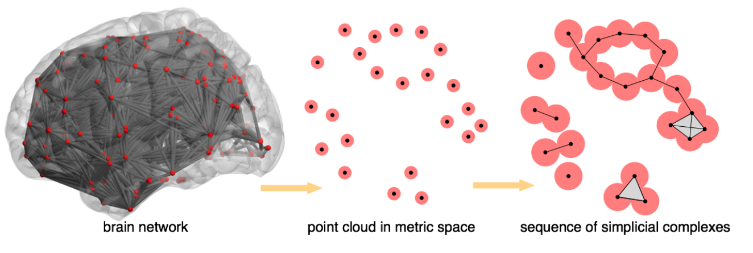
Preserve Brain Topology
Topology of brain networks should be preserved irrespective of sampling density
Metrics capturing topology may be statistically similar across sampling periods, reducing non-neural variability
PH can be robust to changes in data acquisition parameters like sampling period
A. Patania, F. Vaccarino, and G. Petri, “Topological analysis of data,” EPJ Data Science, vol. 6, pp. 1–6, 2017.
Bourakna, A.E.Y., Chung, M.K., Ombao, H. 2022 Topological data analysis for multivariate time series data arXiv:2204.13799

Slide 83
CUDA Programming Model
Globally Sequential Locally Parallel programming pattern
Invokes parallel kernels that execute across a set of threads
CUDA spawns the threads from a hierarchy of grid (3D) and block (3D)
Each thread executes an instance of the kernel
Each thread has thread ID, program counter, registers, and per-thread private memory
Supports C/C++, Fortan, Python
Jason. Sanders. CUDA by example : an introduction to general-purpose GPU programming. Addison-Wesley, Upper Saddle River, NJ, 2011.
Jianbin Fang, Chun Huang, Tao Tang, and Zheng Wang. Parallel programming models for heterogeneous many-cores: a comprehensive survey. CCF Transactions on High Performance Computing, 2(4):382–400, 2020.

Slide 84
GPGPU Challenges
Complex memory hierarchies
Different architectures from multicore CPUs
Convert sequential programming to parallel
Gerassimos Barlas. Chapter 6 - gpu programming. In Gerassimos Barlas, editor, Multicore and GPU Programming, pages 391–526. Morgan Kaufmann, Boston, 2015.
J. D. Owens, M. Houston, D. Luebke, S. Green, J. E. Stone and J. C. Phillips, "GPU Computing," in Proceedings of the IEEE, vol. 96, no. 5, pp. 879-899, May 2008, doi: 10.1109/JPROC.2008.917757.

Slide 85
Join on GPUs: Control Flow Analysis (CFA)
Parallel functional CFA encoded in Datalog utilizes RA as the foundation on GPU
Applied GPU parallelism with multi-node multi-core HPC
Proposed partitioned global address space (PGAS) programming model
THOMAS GILRAY and SIDHARTH KUMAR. Toward parallel cfa with datalog, mpi, and cuda. InScheme and Functional Programming Workshop, 2017.

Slide 86
Advancements in GPU
1970s - 1980s
Basic 2D graphics rendering
1990s
3D graphics accelerators
Early 2000s
Programmable shaders
Parallel processing on GPU
Late 2010s - Early 2020s
AI / ML acceleration
Mid 2000s

Slide 87
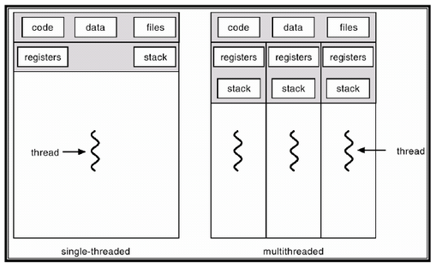
CPU vs GPU (A Sample Machine)
CPU
13th Gen Intel® Core™ i9-13900H
14 cores (6 P-cores + 8 E-cores)
Total 20 threads
Suitable for serial workloads
Access to system memory (RAM)
GPU
NVIDIA GeForce RTX 4070, 8 GB GDDR6
5888 CUDA cores
Total 94,208 threads
Suitable for parallel workloads
Access to dedicated VRAM

Slide 88
Recap to Relational Data
Exascale
Datalog
Declarative analytics
Iterative RA
Topological Data Analysis
Parallel RA
Our approaches
Future work
Conclusion
Relation
Relation: 2-dimensional structure
Attribute: Represents characteristics
Row: Represents unique record
Join (⨝): Combines data from relations
Projection (Π): Select specific columns
UserID | UserName | UserEmail
101 | Alice | alice@example.com
102 | Bob | bob@example.com
Tuple
(Row)
Attribute (Column)
Sidharth Kumar and Thomas Gilray. Distributed relational algebra at scale. In International Conference on High Performance Computing, Data, and Analytics (HiPC). IEEE, 2019.
Sidharth Kumar and Thomas Gilray. Load-balancing parallel relational algebra. In International Conference on High Performance Computing, pages 288–308. Springer, 2020.

Slide 89
Why Join is Important?
Exascale
Datalog
Declarative analytics
Iterative RA
Topological Data Analysis
Parallel RA
Our approaches
Future work
Conclusion
Combine data from multiple tables
Find patterns in data
Clean data
Create new data sets
Daniel Zinn, Haicheng Wu, Jin Wang, Molham Aref, and Sudhakar Yalamanchili. General-purpose join algorithms for large graph triangle listing on heterogeneous systems. In Proceedings of the 9th Annual Workshop on General Purpose Processing Using Graphics Processing Unit, pages 12–21, 2016.

Slide 90
Example of Natural Join ⨝
Exascale
Datalog
Declarative analytics
Iterative RA
Topological Data Analysis
Parallel RA
Our approaches
Future work
Conclusion
User
UserID | UserName | UserEmail
101 | Alice | alice@example.com
102 | Bob | bob@example.com
103 | Eve | eve@example.com
⨝
Order
UserID | OrderTotal | Items
101 | 25.69 | 2
102 | 145.66 | 3
103 | 12.11 | 1
103 | 44.00 | 2

Slide 91
Example of Natural Join ⨝
Exascale
Datalog
Declarative analytics
Iterative RA
Topological Data Analysis
Parallel RA
Our approaches
Future work
Conclusion
User
UserID | UserName | UserEmail
101 | Alice | alice@example.com
102 | Bob | bob@example.com
103 | Eve | eve@example.com
⨝
User
Order
⨝
UserID | UserName | UserEmail | OrderTotal | Items
101 | Alice | alice@example.com | 25.69 | 2
102 | Bob | bob@example.com | 145.66 | 3
103 | Eve | eve@example.com | 12.11 | 1
101 | Alice | alice@example.com | 44.00 | 2
Order
UserID | OrderTotal | Items
101 | 25.69 | 2
102 | 145.66 | 3
103 | 12.11 | 1
103 | 44.00 | 2

Slide 92
Example of Natural Join ⨝
Exascale
Datalog
Declarative analytics
Iterative RA
Topological Data Analysis
Parallel RA
Our approaches
Future work
Conclusion
User
UserID | UserName | UserEmail
101 | Alice | alice@example.com
102 | Bob | bob@example.com
103 | Eve | eve@example.com
⨝
User
Order
⨝
UserID | UserName | UserEmail | OrderTotal | Items
101 | Alice | alice@example.com | 25.69 | 2
102 | Bob | bob@example.com | 145.66 | 3
103 | Eve | eve@example.com | 12.11 | 1
101 | Alice | alice@example.com | 44.00 | 2
Order
UserID | OrderTotal | Items
101 | 25.69 | 2
102 | 145.66 | 3
103 | 12.11 | 1
103 | 44.00 | 2

Slide 93
Example of Natural Join ⨝
Exascale
Datalog
Declarative analytics
Iterative RA
Topological Data Analysis
Parallel RA
Our approaches
Future work
Conclusion
User
UserID | UserName | UserEmail
101 | Alice | alice@example.com
102 | Bob | bob@example.com
103 | Eve | eve@example.com
⨝
User
Order
⨝
UserID | UserName | UserEmail | OrderTotal | Items
101 | Alice | alice@example.com | 25.69 | 2
102 | Bob | bob@example.com | 145.66 | 3
103 | Eve | eve@example.com | 12.11 | 1
101 | Alice | alice@example.com | 44.00 | 2
Order
UserID | OrderTotal | Items
101 | 25.69 | 2
102 | 145.66 | 3
103 | 12.11 | 1
103 | 44.00 | 2

Slide 94
Example of Natural Join ⨝
Exascale
Datalog
Declarative analytics
Iterative RA
Topological Data Analysis
Parallel RA
Our approaches
Future work
Conclusion
User (Outer Relation)
UserID | UserName | UserEmail
101 | Alice | alice@example.com
102 | Bob | bob@example.com
103 | Eve | eve@example.com
⨝
User
Order
⨝
UserID | UserName | UserEmail | OrderTotal | Items
101 | Alice | alice@example.com | 25.69 | 2
102 | Bob | bob@example.com | 145.66 | 3
103 | Eve | eve@example.com | 12.11 | 1
103 | Eve | eve@example.com | 44.00 | 2
Order (Inner Relation)
UserID | OrderTotal | Items
101 | 25.69 | 2
102 | 145.66 | 3
103 | 12.11 | 1
103 | 44.00 | 2

Slide 95
Example of Natural Join ⨝
Exascale
Datalog
Declarative analytics
Iterative RA
Topological Data Analysis
Parallel RA
Our approaches
Future work
Conclusion
User (Outer Relation)
UserID | UserName | UserEmail
101 | Alice | alice@example.com
102 | Bob | bob@example.com
103 | Eve | eve@example.com
⨝
User
Order
⨝
UserID | UserName | UserEmail | OrderTotal | Items
101 | Alice | alice@example.com | 25.69 | 2
102 | Bob | bob@example.com | 145.66 | 3
103 | Eve | eve@example.com | 12.11 | 1
103 | Eve | eve@example.com | 44.00 | 2
Order (Inner Relation)
UserID | OrderTotal | Items
101 | 25.69 | 2
102 | 145.66 | 3
103 | 12.11 | 1
103 | 44.00 | 2

Slide 96
Duplicates on Join Result
Exascale
Datalog
Declarative analytics
Iterative RA
Topological Data Analysis
Parallel RA
Our approaches
Future work
Conclusion
User ⨝ Order
UserID | UserName | UserEmail | OrderTotal | Items
101 | Alice | alice@example.com | 25.69 | 2
102 | Bob | bob@example.com | 145.66 | 3
103 | Eve | eve@example.com | 12.11 | 1
103 | Eve | eve@example.com | 44.00 | 2
Π(_{UserName,UserEmail})(User ⨝ Order)
UserName | UserEmail
Alice | alice@example.com
Bob | bob@example.com
Eve | eve@example.com
Eve | eve@example.com

Slide 97
Hybrid Join Algorithm
Guo et al. proposed PHYJ: SMJ with HJ join
Reduced host-to-device and device-to-host
Fused data communication with GPU execution
On a single GPU achieved up to 1.72X speedup
Can handle skewed data
No information on multiple GPUs or distributed systems
Chengxin Guo, Hong Chen, Feng Zhang, and Cuiping Li. Parallel hybrid join algorithm on gpu. 2019IEEE 21st International Conference on High Performance Computing and Communications; IEEE17th International Conference on Smart City; IEEE 5th International Conference on Data Science andSystems (HPCC/SmartCity/DSS), pages 1572–1579, 2019.
Hongzhi Wang, Ning Li, Zheng ke Wang, and Jianing Li. Gpu-based efficient join algorithms on hadoop.The Journal of Supercomputing, 77:292 – 321, 2020.
Notes:
Introduced a pipeline technique to reduce host-to-device and device-to-host bidirectional communication costs by fusing data communication with GPU execution on setting the input and output relation

Slide 98
Dataset: Stanford large network dataset collection
Graph​ | Type​ | Nodes​ | Edges​
p2p-Gnutella09​ | Directed​ | 8,114​ | 26,013​
p2p-Gnutella04​ | Directed​ | 10,876​ | 39,994​
Skitter​ | Undirected​ | 1,696,415​ | 11,095,298​
roadNet-CA​ | Undirected​ | 1,965,206​ | 2,766,607​
roadNet-TX​ | Undirected​ | 1,379,917​ | 1,921,660​
roadNet-PA​ | Undirected​ | 1,088,092​ | 1,541,898​
SF.cedge​ | Undirected​ | 1,74,955​ | 2,23,001​
cal.cedge​ | Undirected​ | 21,048​ | 21,693​
TG.cedge​ | Undirected​ | 18,263​ | 23,874​
OL.cedge​ | Undirected​ | 6,105​ | 7,035​
Leskovec, J., & Krevl, A. (2014). SNAP Datasets: Stanford large network dataset collection.

Slide 99
Join on CPUs
Processing large amounts of data is a challenging task
Radix hash joins and sort-merge joins have been widely discussed and compared in previous studies
Modern HPC architectures have led to advancements in distributed join algorithms
Most of the multi-core implementations use Message Passing Interface (MPI)
Fundamental part of fixed-point iterative algorithm such as Transitive Closure (TC)

Slide 100
Join on GPUs
GPUs have high memory bandwidth and hierarchy for faster data access
GPUs offer parallel architecture for faster join operation
Data divided into smaller subsets for parallel processing
GPU-based join operation improves performance and scalability

Slide 101
Join on GPUs: LogiQL
Wu et al. presents Red Fox high-performance accelerator core for LogiQL queries
Outperforms multi-threaded CPU-based implementations
Novel: multi-predicate join algorithm (worst-case optimal) on GPU
Issue: deduplication of tuples and maintaining join result in sorted order
Haicheng Wu, Gregory Diamos, Tim Sheard, Molham Aref, Sean Baxter, Michael Garland, andSudhakar Yalamanchili. Red fox: An execution environment for relational query processing on gpus. InProceedings of Annual IEEE/ACM International Symposium on Code Generation and Optimization,pages 44–54, 2014.
Haicheng Wu. Acceleration and execution of relational queries using general purpose graphics processingunit (GPGPU). PhD thesis, Georgia Institute of Technology, 2015.

Slide 102
Join on GPUs: Relational Learning Framework
Expedites rule coverage on GPUs for healthcare records data
Outperforms 75% of applications over multi-core CPU systems
Duplicate tuples not efficiently managed and GPU memory overflows
Carlos Alberto Mart´ınez-Angeles, Haicheng Wu, Inˆes Dutra, V´ıtor Santos Costa, and Jorge BuenabadCh´avez. Relational learning with gpus: Accelerating rule coverage. International Journal of ParallelProgramming, 44(3):663–685, 2016

Slide 103
Parallel Join
What: Perform relational join operation simultaneously on a number of processors or machines
When: Useful when input data is enormous and the join is computationally costly
How: Divide the data into partitions and assign each partition to a different processor
Daniel Zinn, Haicheng Wu, Jin Wang, Molham Aref, and Sudhakar Yalamanchili. General-purpose join algorithms for large graph triangle listing on heterogeneous systems. In Proceedings of the 9th Annual Workshop on General Purpose Processing Using Graphics Processing Unit, pages 12–21, 2016.

Slide 104
Modern Implementations of Datalog
LogicBlox
Soufflé
RadLog
PRAM
SLOG

Slide 105
LogicBlox
Gradual advances in logic programming: Advancement over the years
LogiQL language: Datalog-like, null-free
LogicBlox system: Mature, enterprise-integrated
Massive financial benefits: $300B in revenue for business analytics
Molham Aref, Balder ten Cate, Todd J. Green, Benny Kimelfeld, Dan Olteanu, Emir Pasalic, Todd L.Veldhuizen, and Geoffrey Washburn. Design and implementation of the logicblox system. In Proceedingsof the 2015 ACM SIGMOD International Conference on Management of Data, SIGMOD ’15, page1371–1382, New York, NY, USA, 2015. Association for Computing Machinery

Slide 106
Soufflé
A variant of Datalog for static analysis using OpenMP
State-of-the-art implementation for multi-core CPU systems with single-node
Translates Datalog programs to optimized C++ programs
Supports limited number of threads for task-level parallelism
Cannot provide data parallelism
Herbert Jordan, Bernhard Scholz, and Pavle Suboti´c. Souffl´e: On synthesis of program analyzers. InInternational Conference on Computer Aided Verification, pages 422–430. Springer, 2016.
Thomas Gilray, Sidharth Kumar, and Kristopher Micinski. Compiling data-parallel datalog. InProceedings of the 30th ACM SIGPLAN International Conference on Compiler Construction, CC 2021,page 23–35, New York, NY, USA, 2021. Association for Computing Machinery.

Slide 107
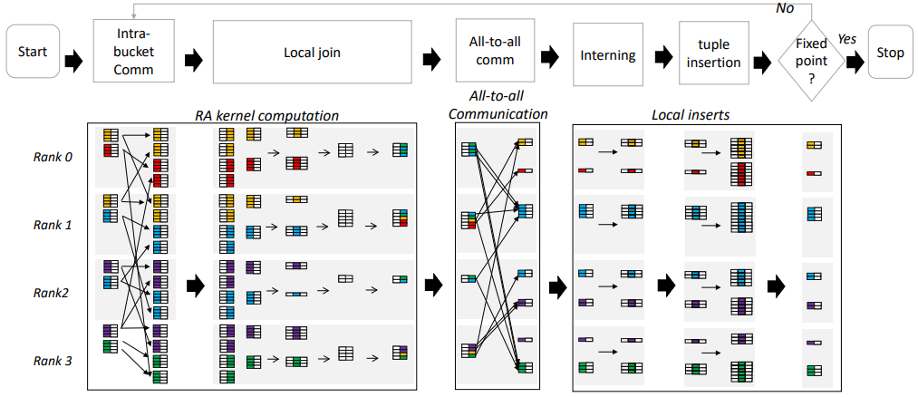
SLOG
High-performance implementation providing a compiler, REPL, and runtime
Uses PRAM as relational algebra backend
Outperforms Soufflé and RadLog for higher core counts
Does not yet utilize GPU devices
Thomas Gilray, Arash Sahebolamri, Sidharth Kumar, and Kristopher Micinski. Higher-order, dataparallel structured deduction. arXiv preprint arXiv:2211.11573, 2022.
Thomas Gilray, Sidharth Kumar, and Kristopher Micinski. Compiling data-parallel datalog. InProceedings of the 30th ACM SIGPLAN International Conference on Compiler Construction, pages23–35, 2021.

Slide 108
Join on CPUs: Fault Tolerant Hash Joins
Nasibullin and Novikov developed a distributed fault-tolerant hash-join
Utilizes data replication and alive signals for fault detection and recovery
Can handle a single point of failure with a keeper-worker model
Does not outperform distributed hash join algorithms in a failure-free situation
Can be criticized for data skewness and lack of accelerator use
Arsen Nasibullin and Boris Novikov. Fault tolerant distributed hash-join in relational databases. InFifth Conference on Software Engineering and Information Management (SEIM-2020), pages 11–17,2020.

Slide 109
Datalog on GPUs
Outperforms non-GPU systems for join and transitive closure computation
Use GPU kernels to eliminate unnecessary tuples, join, and project
Achieved up to 40x performance enhancement over single CPU system
Limitation in relation size and applicability to distributed platforms
Carlos Alberto Mart´ınez-Angeles, Inˆes Dutra, V´ıtor Santos Costa, and Jorge Buenabad-Ch´avez. Adatalog engine for gpus. In Declarative Programming and Knowledge Management: DeclarativeProgramming Days, KDPD 2013, Unifying INAP, WFLP, and WLP, Kiel, Germany, September 11-13,2013, Revised Selected Papers 0, pages 152–168. Springer, 2014.
Grigoris Antoniou, Sotiris Batsakis, Raghava Mutharaju, Jeff Z. Pan, Guilin Qi, Ilias Tachmazidis,Jacopo Urbani, and Zhangquan Zhou. A survey of large-scale reasoning on the web of data. TheKnowledge Engineering Review, 33, 2018.

Slide 110
Persistent Homology (PH)
Investigates connections between different parts of complex networks using simplicial complexes
Simplicial complexes represent topological spaces as collections of simplices (points, line segments, triangles, etc.)
Detects topological features and measures the significance of relationships across multiple thresholds
Topological features refer to the 0-, 1-, 2- dimensional homology groups of a metric space describing connected components, tunnels, and voids
0-simplex (connected component)
1-simplex (tunnel)
2-simplex (void)
M. Rubinov and O. Sporns, “Complex network measures of brain connectivity: uses and interpretations,” Neuroimage, vol. 52, no. 3, pp. 1059–1069, 2010.
Aktas, M.E., Akbas, E. & Fatmaoui, A.E. Persistence homology of networks: methods and applications. Appl Netw Sci 4, 61 (2019). https://doi.org/10.1007/s41109-019-0179-3

Slide 111
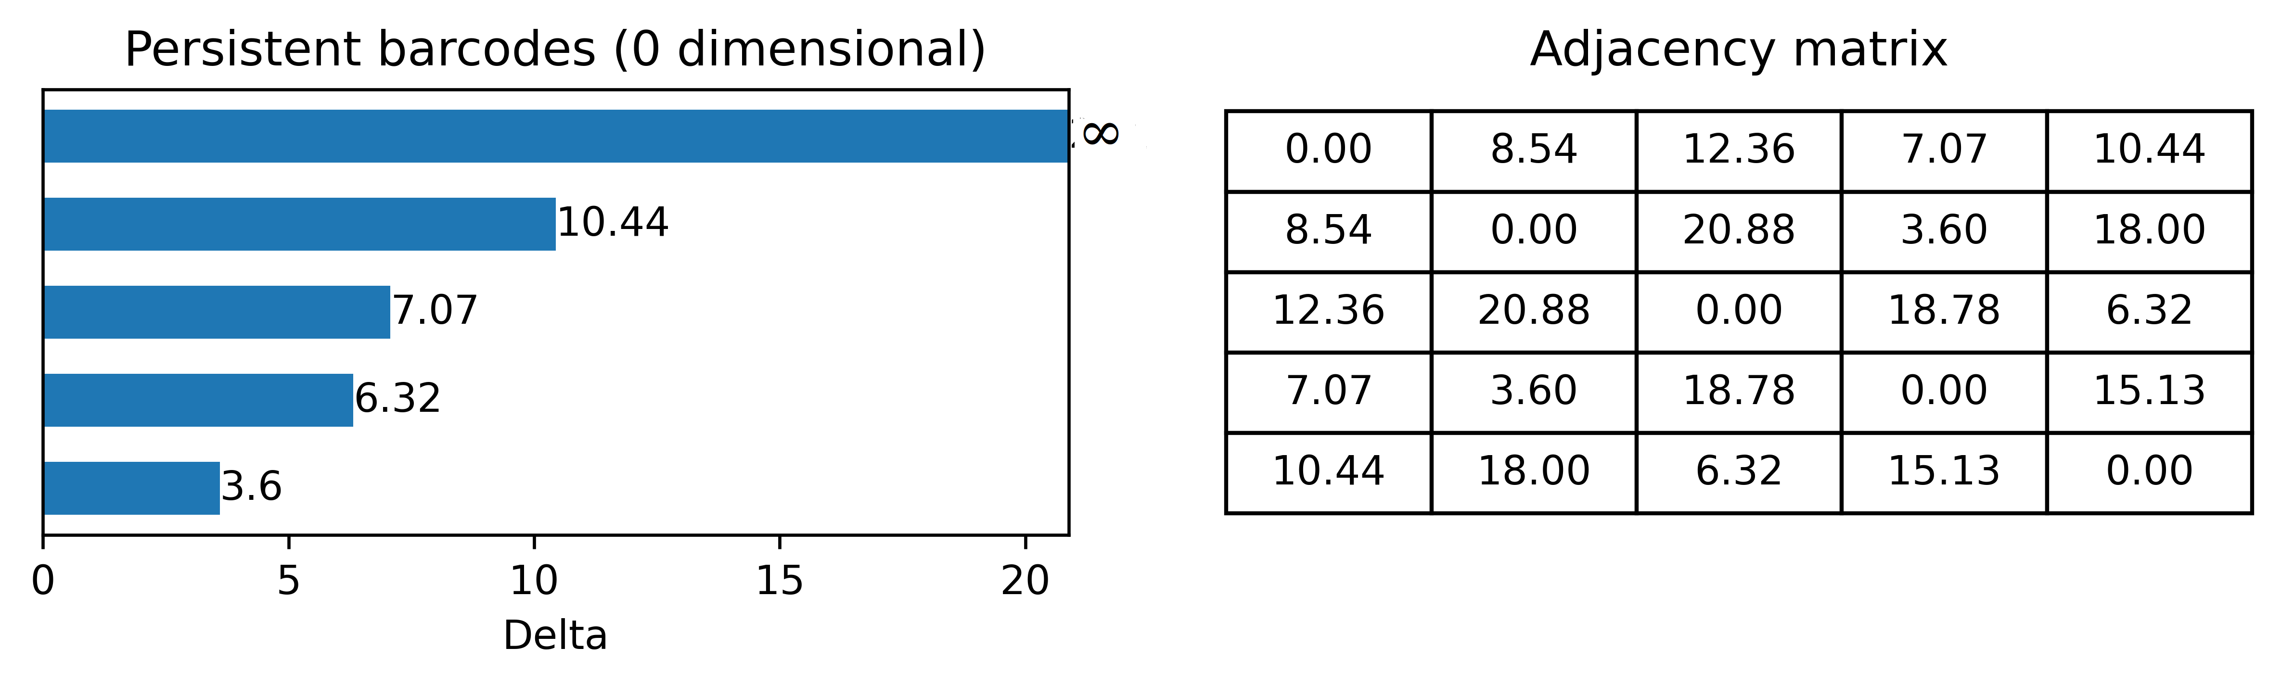
Barcodes and Persistent Diagram
PH can track when features are created and destroyed with varying scales
Quantifies birth and death of features in the graph according to their significance
Represented in the form of barcodes, a fingerprint for a graph
Persistent diagram: points in 2D plane obtained from barcodes, represent topological feature persistence with x as birth time and y as death time
Aktas, M.E., Akbas, E. & Fatmaoui, A.E. Persistence homology of networks: methods and applications. Appl Netw Sci 4, 61 (2019). https://doi.org/10.1007/s41109-019-0179-3

Slide 112
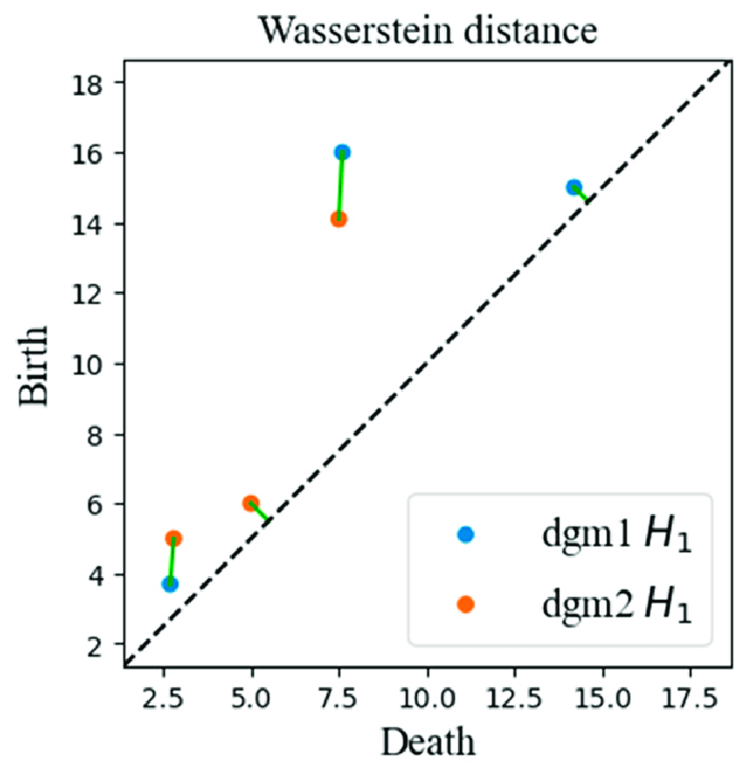
Wasserstein distance (WD)
Wasserstein distance (Earth Mover's Distance) measures distance between two probability distributions
Minimum amount of work required to transform u into v, work = distribution weight x distance
Minimum value achieved by a perfect matching between the features of two Persistent Diagrams
S. Vallender, “Calculation of the wasserstein distance between probability distributions on the line,” Theory of Probability & Its Applications, vol. 18, no. 4, pp. 784–786, 1974.
H. Edelsbrunner, “Persistent homology: theory and practice,” 2013.
Qingzhang, Shi. (2021). Time Series Clustering with Topological and Geometric Mixed Distance. Mathematics. 9. 10.3390/math9091046.

Slide 113
Experimental data and network construction
Structural T1-weighted and rs-fMRI data were obtained from the publicly available Enhanced Nathan Kline Institute Rockland Sample database (NKI-RS)
The MRI data from 3T Siemens Magnetom Tim Trio scanner
The rs-fMRI data were acquired from each subject using 3 acquisition protocols with 3 temporal sampling rates (645ms, 1400ms, 2500ms)
Total number of subjects: 316 with mean time series from 113 brain regions
One weighted network per fMRI scan
K. B. Nooner, S. Colcombe, R. Tobe, M. Mennes, M. Benedict, A. Moreno, L. Panek, S. Brown, S. Zavitz, Q. Li et al., “The nki-rockland sample: a model for accelerating the pace of discovery science in psychiatry,” Frontiers in neuroscience, vol. 6, p. 152, 2012.

Slide 114
Embed FCNs in metric space
To map the association between two nodes u and v in the brain network, their Pearson's correlation coefficients corr(u, v) are used
The objective is to transform this association into a distance metric where stronger correlations between nodes correspond to shorter distances
Mapping to all 316 subjects across 3 temporal frequencies:
d(u, v) = 1 – corr(u, v)
Included both positive and negative correlations
Generates symmetric adjacency matrix with size 113 x 113 using Pearson's correlation
Total adjacency matrices: 948 (316 x 3)
B. Cassidy, C. Rae, and V. Solo, “Brain activity: Conditional dissimilarity and persistent homology,” in 2015 IEEE 12th International Symposium on Biomedical Imaging (ISBI), 2015, pp. 1356–1359.
S. M. Smith, K. L. Miller, G. Salimi-Khorshidi, M. Webster, C. F. Beckmann, T. E. Nichols, J. D. Ramsey, and M. W. Woolrich, “Network modelling methods for fmri,” Neuroimage, vol. 54, no. 2, pp. 875–891, 2011.

Slide 115
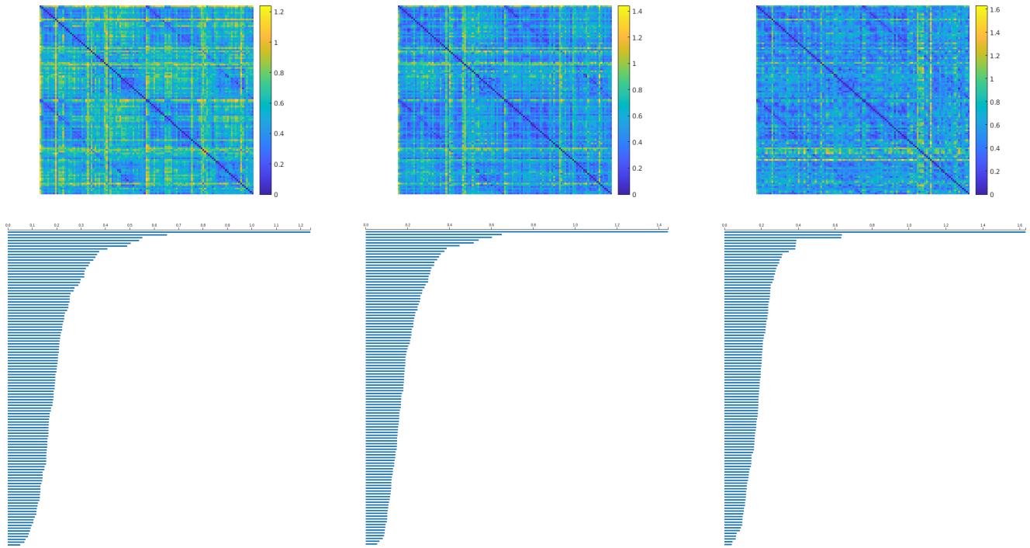
Apply PH to metric space
Apply PH on the metric space to extract topological features
Compute 0-dimensional barcodes for all FCNs (3 x 316)
FCN (top-row) and extracted topological feature (bottom-row) for subject 31 for 645ms (left), 1400ms (center), and 2500ms (right)
The GUDHI Project, GUDHI User and Reference Manual. GUDHI Editorial Board, 2015. [Online]. Available: http://gudhi.gforge.inria.fr/doc/latest/
M. Kerber, D. Morozov, and A. Nigmetov, “Geometry helps to compare persistence diagrams,” Journal of Experimental Algorithmics (JEA), vol. 22, pp. 1–20, 2017.

Slide 116
Statistical analysis on PDs
Convert extracted barcodes to persistent diagram (PD)
Quantify the difference between two PDs using Wasserstein distance
Wasserstein metrics provides the foundation of the statistical inference framework
Performed 3 kinds of statistical analysis:
Across cohort study
Within cohort study
Comparision with traditional FCN analysis
S. Vallender, “Calculation of the wasserstein distance between probability distributions on the line,” Theory of Probability & Its Applications, vol. 18, no. 4, pp. 784–786, 1974.
H. Edelsbrunner, “Persistent homology: theory and practice,” 2013.

Slide 117
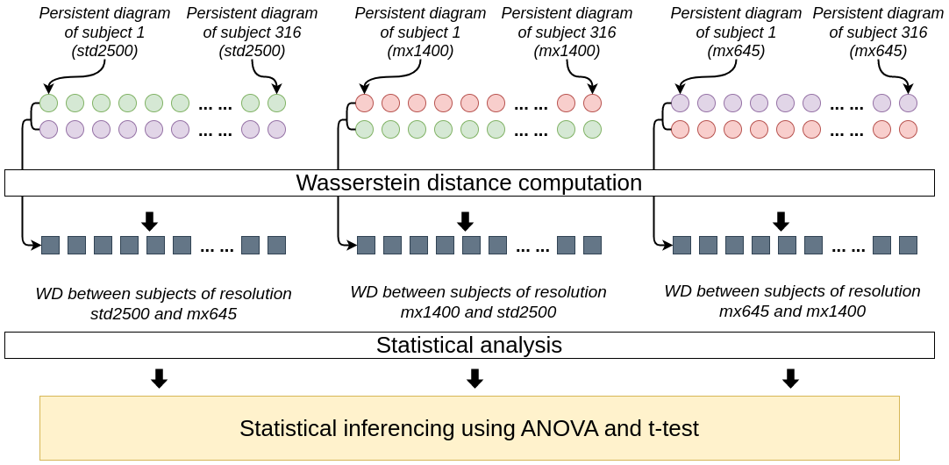
Across Cohort Study
Perform comparison of PDs across cohorts using Wasserstein distance
For each subject compute 3 WD
2500ms and 645ms
1400ms and 2500ms
645ms and 1400ms
Form 3 distributions each with 316 datapoints
Apply Analysis of Variance (ANOVA) and t-test on the distributions
High p-value (>0.05) will indicate the null hypothesis is true
Pipeline to compare WD across cohorts
R. T. Shinohara, J. Oh, G. Nair, P. A. Calabresi, C. Davatzikos, J. Doshi, R. G.Henry, G. Kim, K. A. Linn, N. Papinutto et al., “Volumetric analysis from a harmonized multisite brain mri study of a single subject with multiple sclerosis,” American Journal of Neuroradiology, vol. 38, no. 8, pp. 1501–1509, 2017.

Slide 118
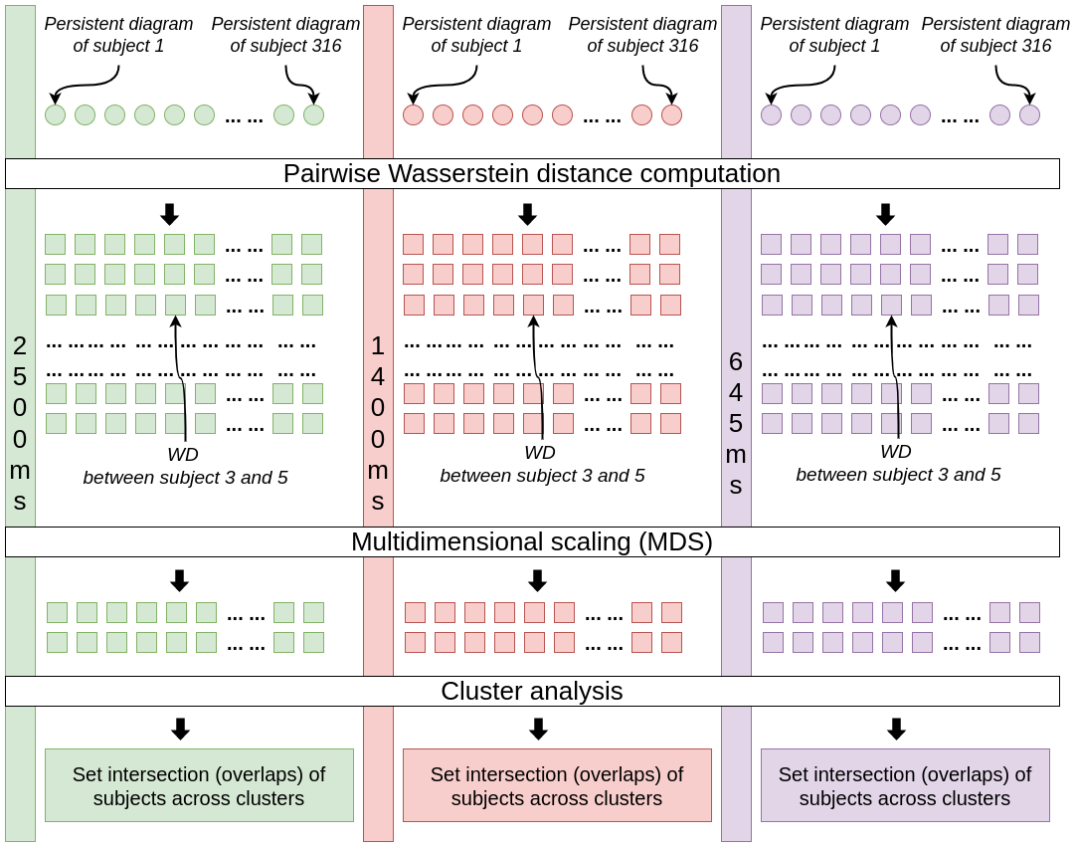
Within Cohort Study
Perform comparison of pairwise WD between PDs of subjects within each cohort
Generate 3 adjancency matrix of size 316 x 316
Reduce the dimension using 2-components MDS (matrix size 316 x 2)
Apply K-Means clustering with Silhoutte coefficient
Computes set interaction of the subjects across clusters
Pipeline to compare WD within a given cohort
Chung, M. K., Huang, S. G., Carroll, I. C., Calhoun, V. D., & Goldsmith, H. H. (2022). Dynamic Topological Data Analysis for Brain Networks via Wasserstein Graph Clustering. arXiv preprint arXiv:2201.00087.

Slide 119
Comparison with traditional FCN analysis
Use raw FCN instead of using PH features
Perform ANOVA test across all subjects for each node of the raw FCN
Compute 1 p-value per entry of the FCN
As FCN size is 113 x 113, generates 113 x 113 p-values
Threshold the p-values with significance level of α = 0.05
Assign 1 if p-value is less than the threshold, 0 otherwise
If majority of the value are 1, then it will indicate that FCN acquired from different sampling periods are different
Feng, W., Liu, G., Zeng, K., Zeng, M., & Liu, Y. (2022). A review of methods for classification and recognition of ASD using fMRI data. Journal of neuroscience methods, 368, 109456.

Slide 120
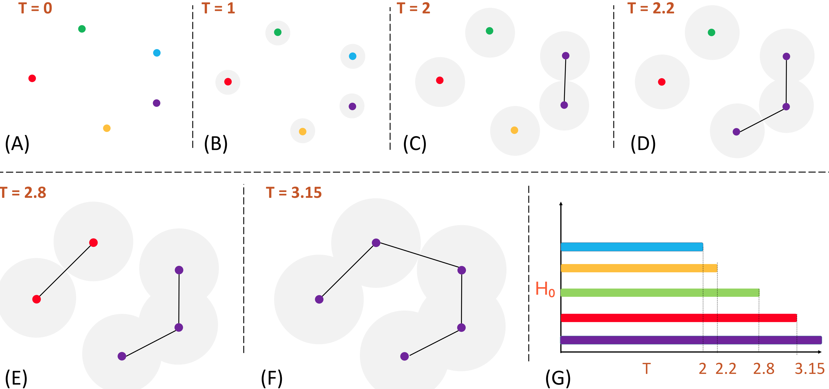
Computing Persistent Homology (Point Cloud)

Slide 121
Computing Persistent Homology (Point Cloud)

Slide 122
Computing Persistent Homology (Point Cloud)

Slide 123
Computing Persistent Homology (Point Cloud)

Slide 124
Computing Persistent Homology (Point Cloud)

Slide 125
Computing Persistent Homology (Point Cloud)

Slide 126
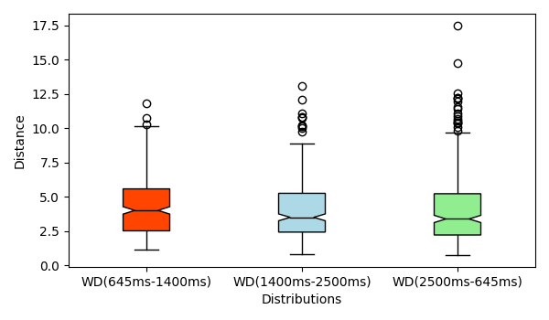
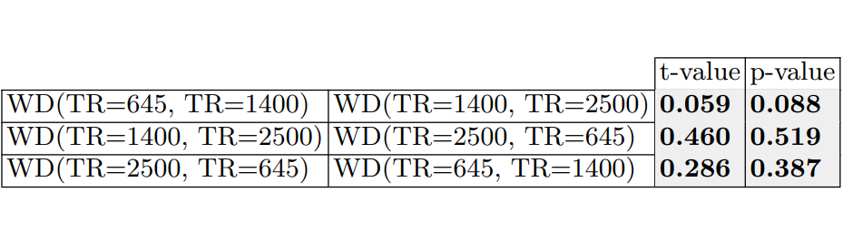
Across Cohort Study Results
Boxplots are aligned indicating similarity of the three distributions
ANOVA test yields p-value of 0.29
T-values and p-values are greater than the significance level of α = 0.05
Boxplot and t-test results for across study, significance level of α = 0.05

Slide 127
Functional Connectivity Networks Analysis
FCNs use Pearson's correlation to measure time series association
Multi-site rs-fMRI studies recruit faster, larger samples
Sensitive to data acquisition parameters (sampling rates)
Non-neural variability negates advantages of larger sample sizes
B. B. Biswal, M. Mennes, X.-N. Zuo, S. Gohel, C. Kelly, S. M. Smith, C. F. Beckmann, J. S. Adelstein, R. L. Buckner, S. Colcombe et al., “Toward discovery science of human brain function,” Proceedings of the national academy of sciences, vol. 107, no. 10, pp. 4734–4739, 2010.
C. Dansereau, Y. Benhajali, C. Risterucci, E. M. Pich, P. Orban, D. Arnold, and P. Bellec, “Statistical power and prediction accuracy in multisite resting-state fmri connectivity,” Neuroimage, vol. 149, pp. 220–232, 2017.

Slide 128
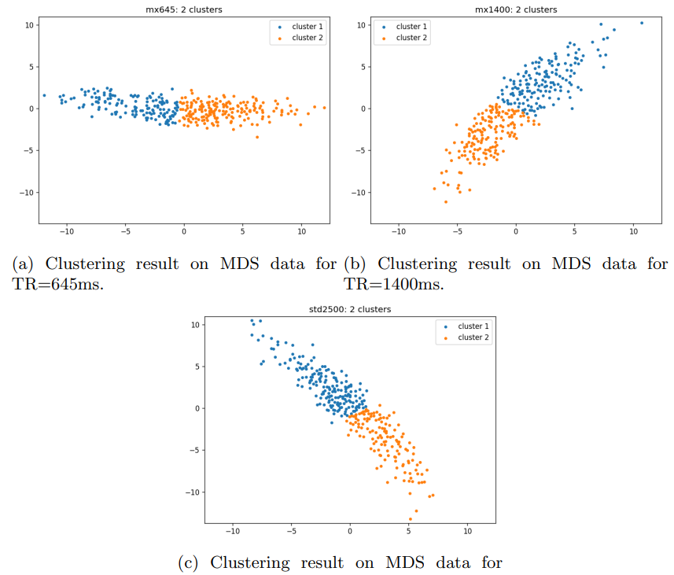
Within Cohort Study Results
Apply K-Means clustering with Silhoutte score on 2-components MDS, 3 matrices (316 X 2)
198 out of 316 subjects reside in same cluster group in all 3 TRs
251 out of 316 subjects reside in same pairwise cluster intersection
Compared against random FCNs which which gave p-value of 0
MDS plots of three data cohorts

Slide 129
Parallel Join (Continue)
Design
Consider partition, load balancing, communication
Challenging due to the uncertain output size
Efficient joins requires sorting or indexing
Optimize
Implement
Daniel Zinn, Haicheng Wu, Jin Wang, Molham Aref, and Sudhakar Yalamanchili. General-purpose join algorithms for large graph triangle listing on heterogeneous systems. In Proceedings of the 9th Annual Workshop on General Purpose Processing Using Graphics Processing Unit, pages 12–21, 2016.

Slide 130
Exascale Supercomputers
Aurora (ANL)
Frontier (ORNL)
El Capitan (LLNL)
Evans, T. M., Siegel, A., Draeger, E. W., Deslippe, J., Francois, M. M., Germann, T. C., ... & Martin, D. F. (2022). A survey of software implementations used by application codes in the Exascale Computing Project. The International Journal of High Performance Computing Applications, 36(1), 5-12.
D. Kothe, S. Lee and I. Qualters, "Exascale Computing in the United States," in Computing in Science & Engineering, vol. 21, no. 1, pp. 17-29, 1 Jan.-Feb. 2019, doi: 10.1109/MCSE.2018.2875366.

Slide 131
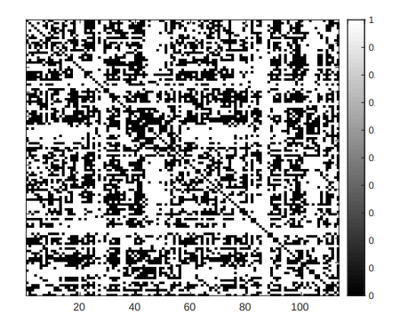
Comparison with traditional FCN analysis results
Majority pixels are black corresponding to a p-value < significance level of α = 0.05
7731 connections show FCNs are different for 3 TRs while 5037 connections are not
Traditional FCN analysis fails to identify connections from same subjects with different TRs
Results after ANOVA test on raw FCNs of 316 subjects, white pixels indicate no matching of the same subject across different TRs

Slide 132
Table of Contents
Exascale Computing
Datalog
Declarative Analytics using Datalog Applications
Iterative Relational Algebra
Parallel Join
Our Approaches
Topological Data Analysis for High-Dimensional Data
Future Research Direction
Conclusion

